Slide 1
C. Cultural: Religion, philosophy, education, art, music, literature, architecture

Slide 2
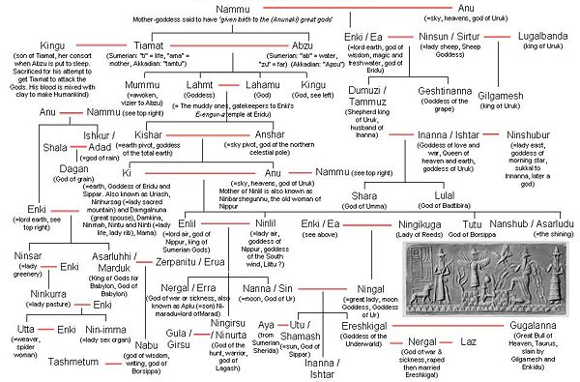
Iv. Culture of Mesopotamia & egypt
Most ancient people were polytheistic – believing in many different Gods.
Sumerian Gods: family tree

Slide 3
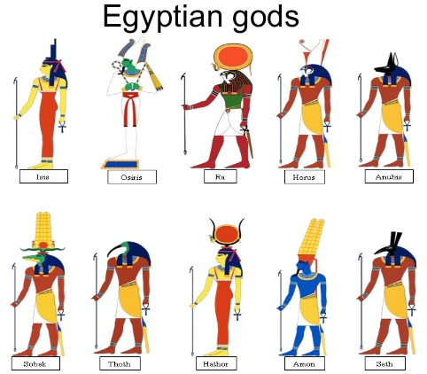
Iv. Culture of Mesopotamia & egypt
The gods played important roles in the daily lives of the ancient Egyptians. There were two levels of gods:
local gods
national gods
Gods were used for:
Daily Rituals
Festivals
Shrines
Offerings to the dead
Hymns and prayers
Religious ceremonies

Slide 4
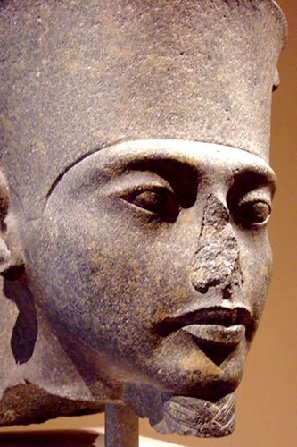
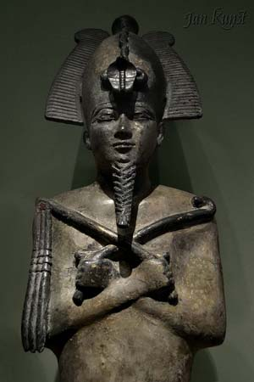
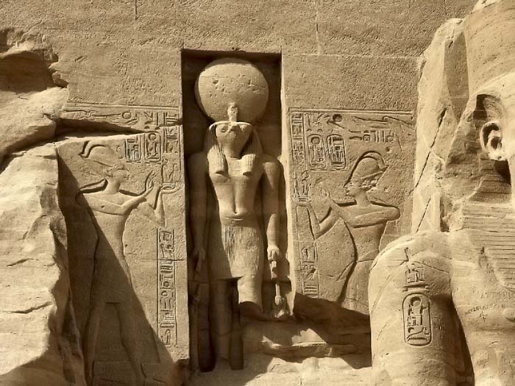
Iv. Culture of Mesopotamia & egypt
Ra is the ancient Egyptian sun god. He is the father of the gods and is usually depicted with the body of a human and the head of a falcon.
Osiris was the god of the dead and resurrection.

Slide 5
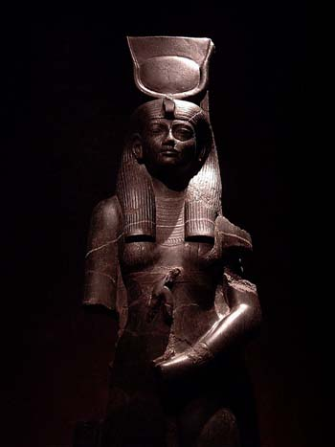
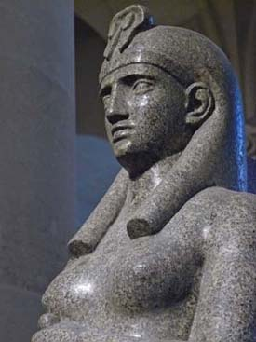
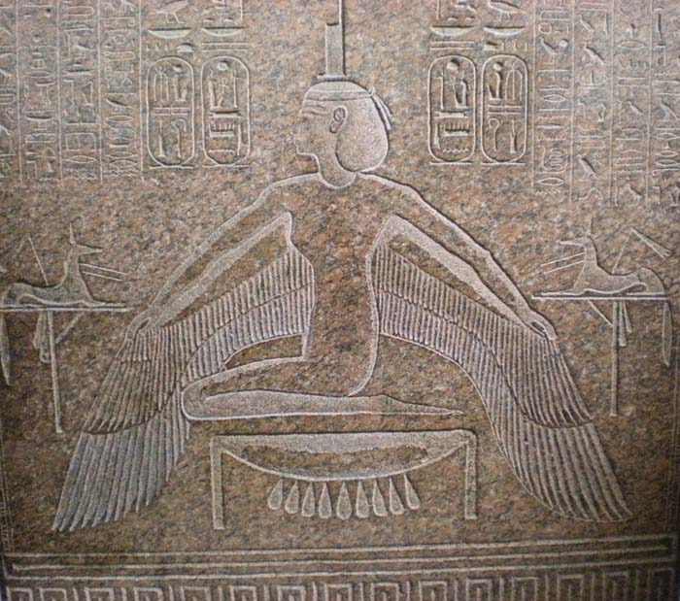
Iv. Culture of Mesopotamia & egypt
Isis was a fertility goddess and a mother goddess.
Ma’at was the representation of moral and physical law. Some scholars consider her the most important goddess of Ancient Egypt.
Ma’at’s worship spread throughout Egypt because she helped judge the dead.

Slide 6
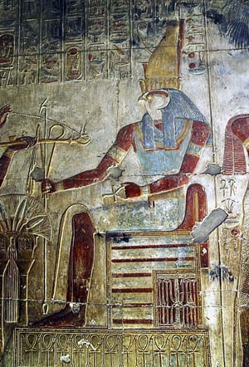
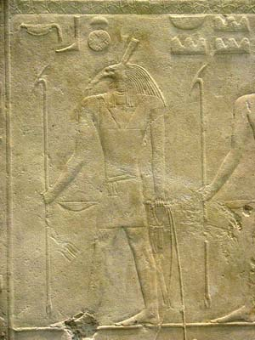
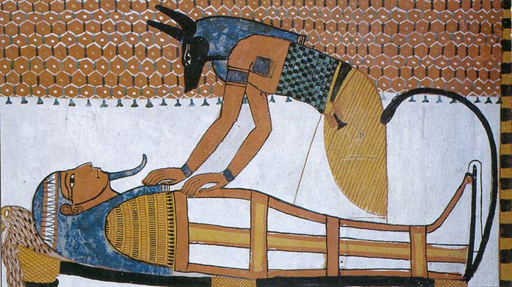
Iv. Culture of Mesopotamia & egypt
Anubis is the god of death and dying.
He is also considered to be the god of the underworld.
Seth was the god of evil and darkness.
people regarded the color red as an evil color because of its connection to Set.
Horus was a sun god and the king of the gods. “The living Horus” was one of the pharaoh’s titles
His emblem was the falcon

Slide 7
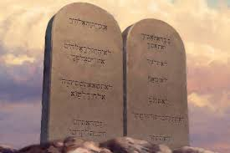
Iv. Culture of Mesopotamia & egypt
The Israelites (Hebrews-Jewish) in Palestine were the 1st group in history to be monotheistic – believing in 1 God

Slide 8
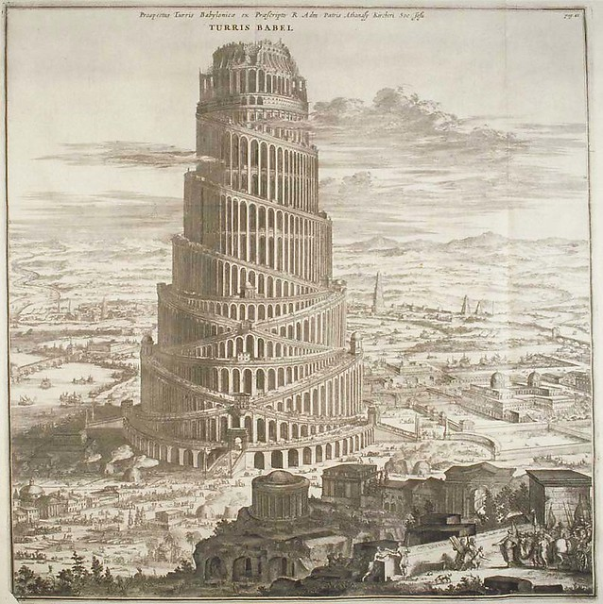
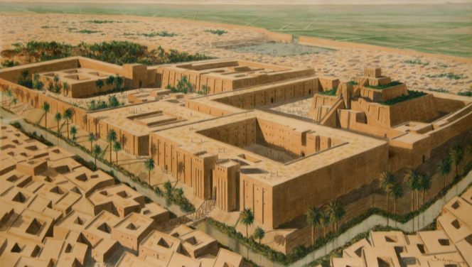
Iv. Culture of Mesopotamia & egypt
Art and architecture was used as propaganda and to show power – the bigger the structure the more powerful!
This is true throughout history – Rome, Napoleon, Hitler, USA – Propaganda is a vital part of advancing power in the world!

Slide 9
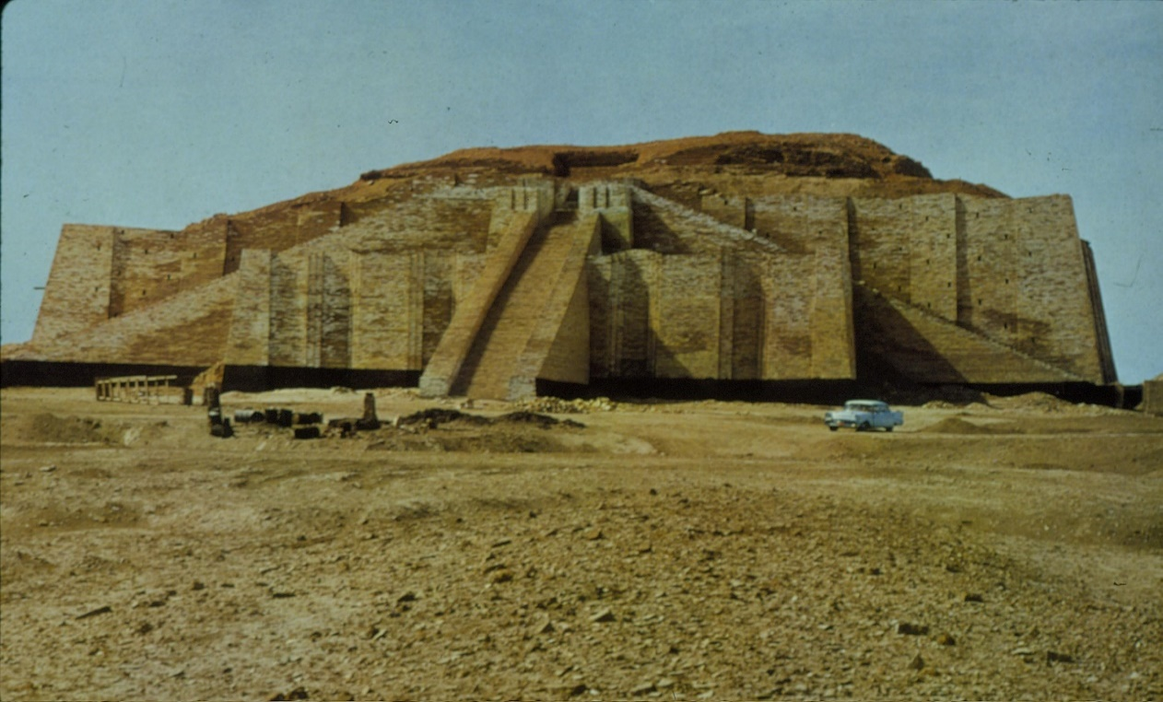
Iv. Culture of Mesopotamia & egypt
At the city center was a temple called a ziggurat
Ziggurat – The 1st stepped pyramids ever created – possibly for local religious

Slide 10
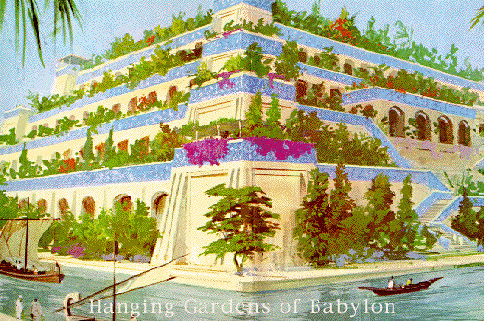
Iv. Culture of Mesopotamia & egypt
Nebuchadnezzar was famous for creating one of 7 wonders of the ancient world – the Hanging Gardens of Babylon

Slide 11
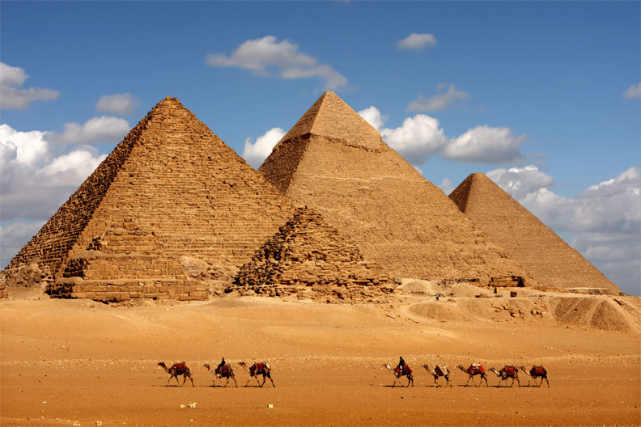
Iv. Culture of Mesopotamia & egypt
The great pyramids of GIZA
Great Pyramid (Khufu’s pyramid or Pyramid of Cheops)
Pyramid of Khafre
Pyramids of Menkaure
Used as tombs for pharaohs (the most famous was that of King TUT)
20-30 years to build
481 feet tall
Skilled workers were used to build

Slide 12
Iv. Culture of Mesopotamia & egypt

Slide 13
Iv. Culture of Mesopotamia & egypt

Slide 14
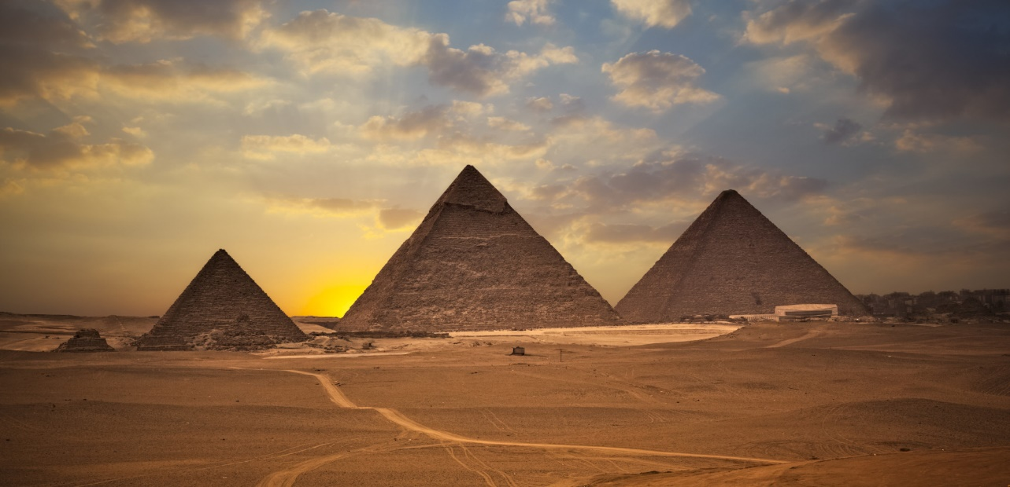
Iv. Culture of Mesopotamia & egypt
http://www.3dmekanlar.com/en/the-pyramids-1.html

Slide 15
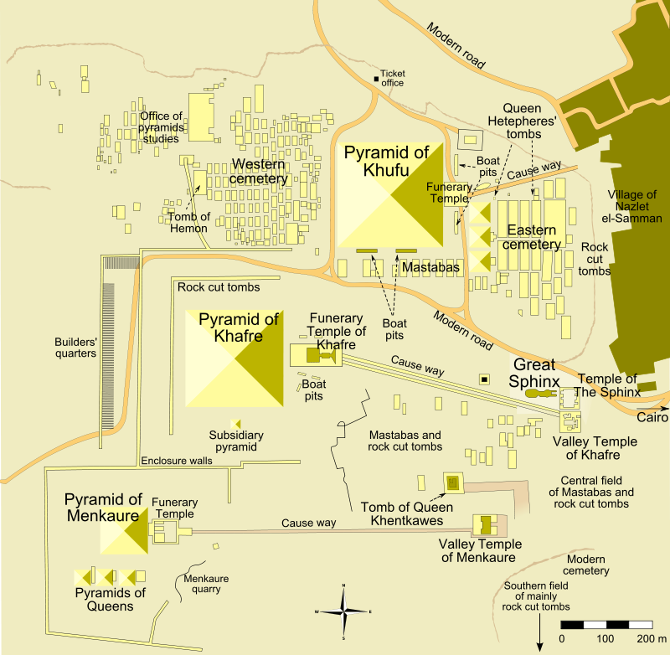
Iv. Culture of Mesopotamia & egypt
Giza Pyramid
Complex

Slide 16
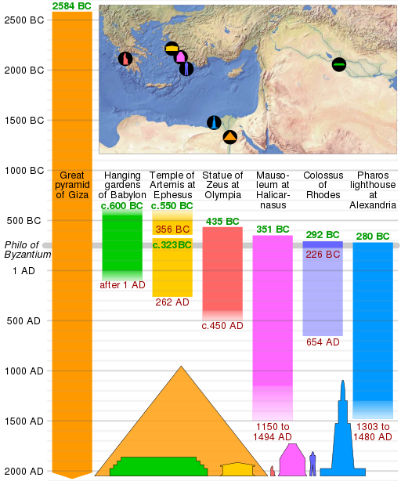
Iv. Culture of Mesopotamia & egypt
7 wonders of the ancient world

Slide 17
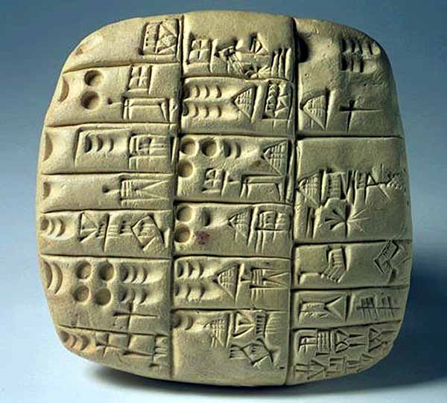
Iv. cultural ASPECTS OF MESOPOTAMIA
Writing was used to record historical tradition, religious purposes, or trade and taxes
Mesopotamians created the first form of writing, known as Cuneiform.
Early writing used were pictographs

Slide 18
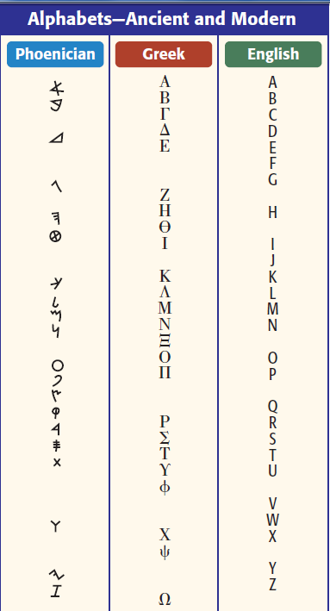
Iv. cultural ASPECTS OF MESOPOTAMIA
Sumerians wrote the 1st epic of history – The Epic of Gilgamesh
7,000 texts are found from the Akkadian Empire.
This ancient empire is mentioned in the Old Testament of the Bible

Slide 19
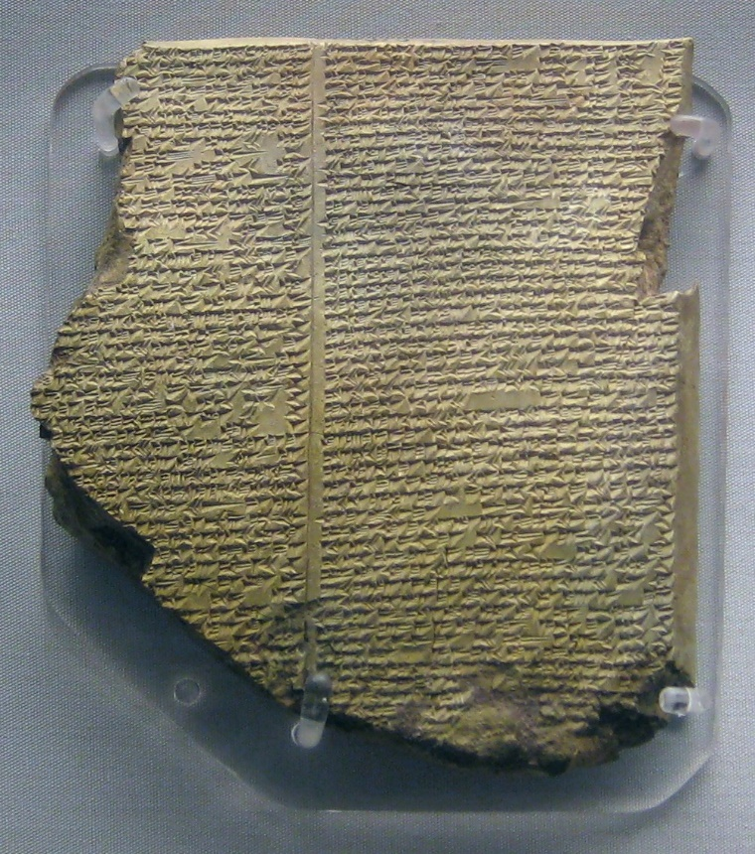
Iv. cultural ASPECTS OF MESOPOTAMIA
Egyptian hieroglyphics was both pictograms & a phonetic alphabet
Hieroglyphics were translated using the Rosetta Stone
It has 3 languages – each displaying the same content
This was found in the early 1800’s by Napoleon’s army while marching toward Egypt.

Slide 20
Iv. cultural ASPECTS OF MESOPOTAMIA

Slide 21
e. economics: agriculture, Industry, money, capitalism, socialism

Slide 22
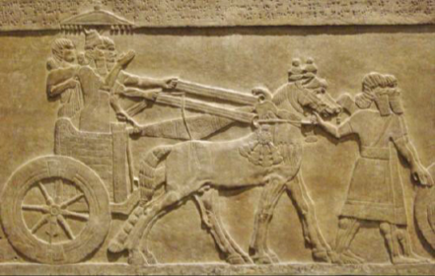
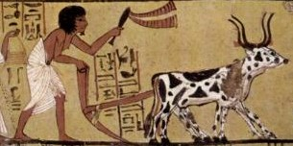
v. economics OF MESOPOTAMIA & egypt
Job Specialization allowed empires to make things that were essential to the city.
Inventions: the wheel, sail, plow, & bronze metalwork
These advances allowed the Sumerians to advance at a rapid pace and to trade and make money

Slide 23
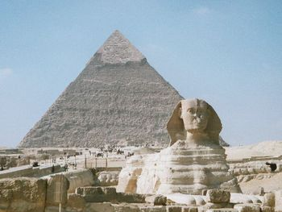
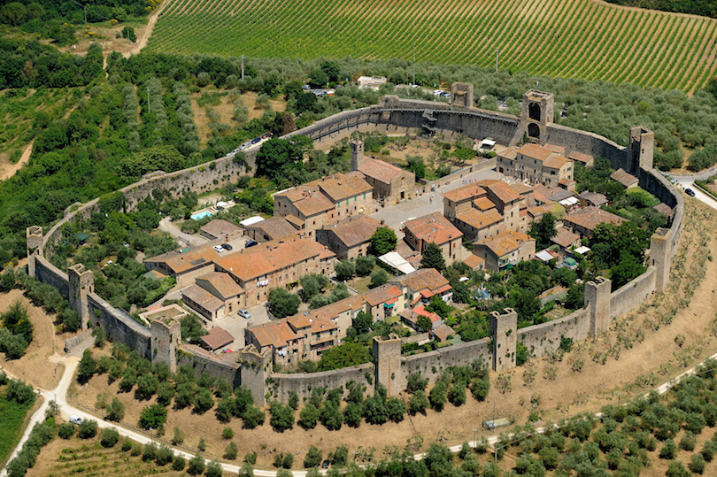
v. economics OF MESOPOTAMIA & egypt
Strong rulers ordered big public works programs like tombs, complex water systems or walls.
This would defend them and increase the reputation and power of the city

Slide 24
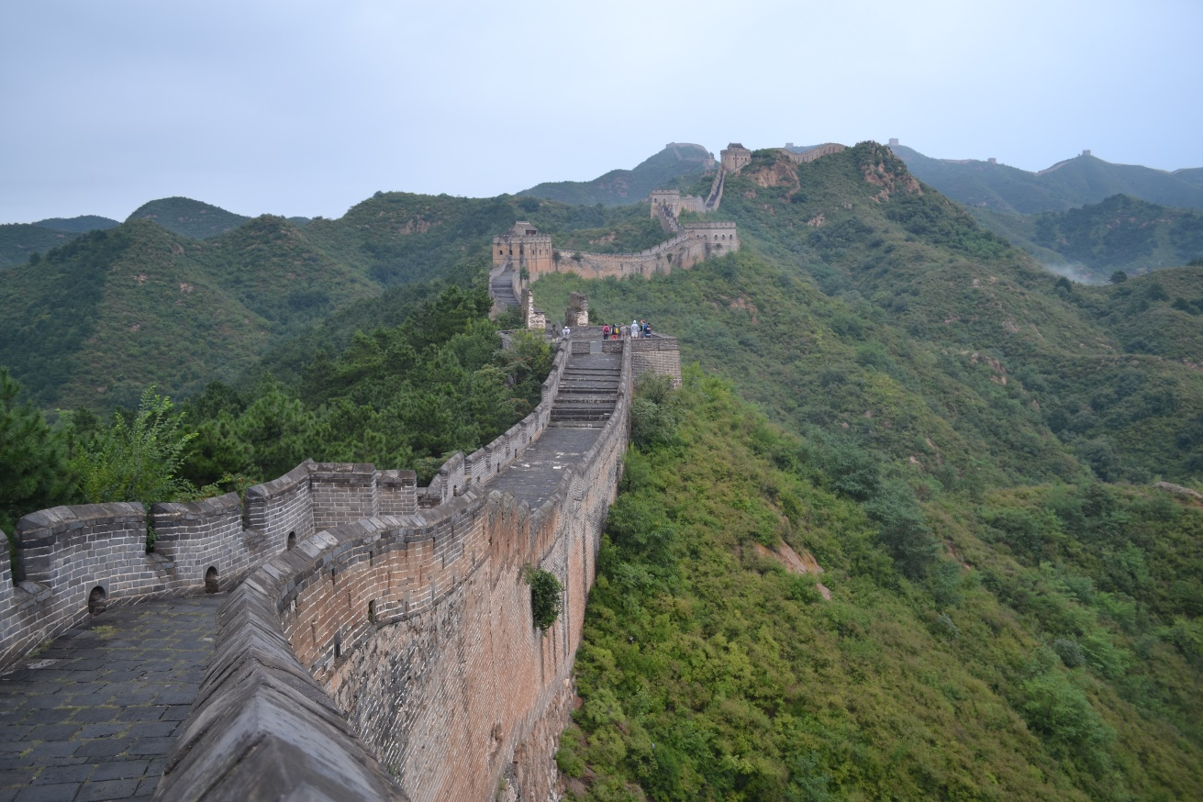
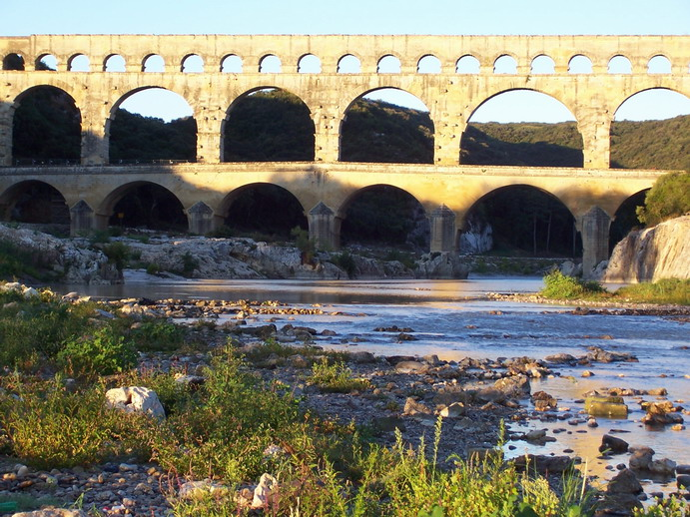

Slide 25
S. Social:
Family, gender roles,
class structures, race
P. Political:
Government, War,
Laws, organizations
I. Interactions: Geography, Disease, migration, settlement, technology
C. Cultural: Religion, philosophy, education, art, music, literature, architecture
E. economics: agriculture, Industry, money, capitalism, socialism

