Slide 1
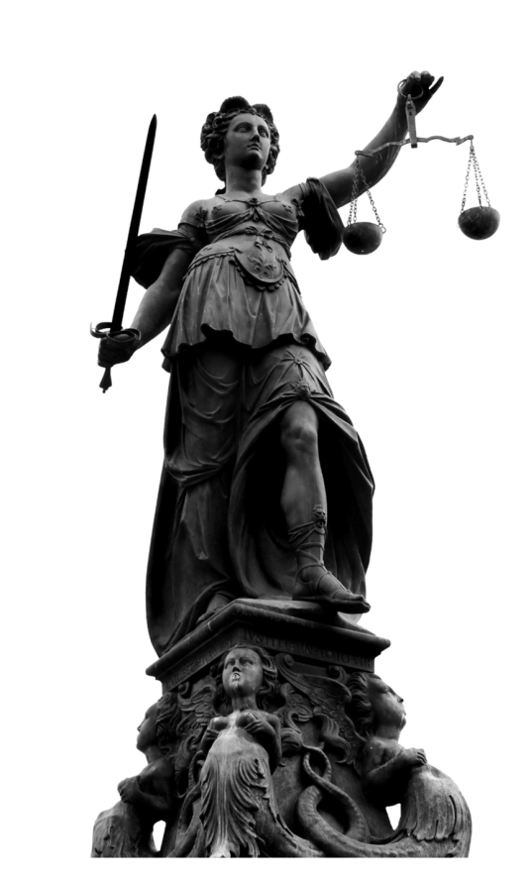
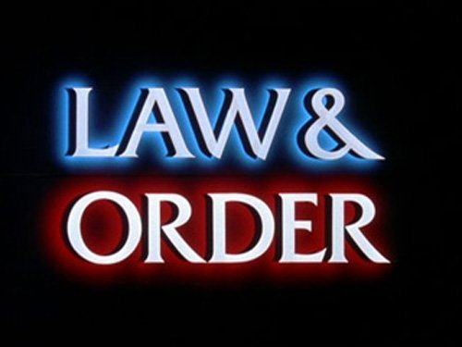
TRIAL INFORMATION
Steps, vocabulary

Slide 2
Steps in a Trial
Judge enters and takes the Bench (all rise)
Clerk announces the case
Prosecuting attorneys make opening statement
Defense attorneys make opening statement
Prosecutions presents case:
Prosecution calls 1st witness (direct examination)
Defense cross examines the witness
Prosecution conducts redirect examination
Repeat steps 1-3 for every Prosecution witness
-continued

Slide 3
Steps in a Trial
Prosecution rests its case
Defense presents cases:
Defense calls 1st witness (direct examination)
Prosecution cross examines the witness
Defense conducts redirect examination
Repeat steps 1-3 for every Defense witness
Defense rests its case
Prosecution makes closing argument
Defense makes closing argument
-continued

Slide 4
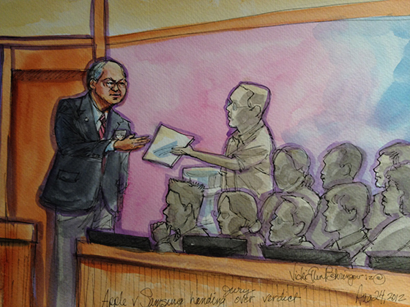
Steps in a Trial
Jury instructions by the Judge
Jury deliberations (in the hall way)
Verdict (made by the jury, handed to the bailiff, announced by the judge)
Sentence (given by the
judge)

Slide 5
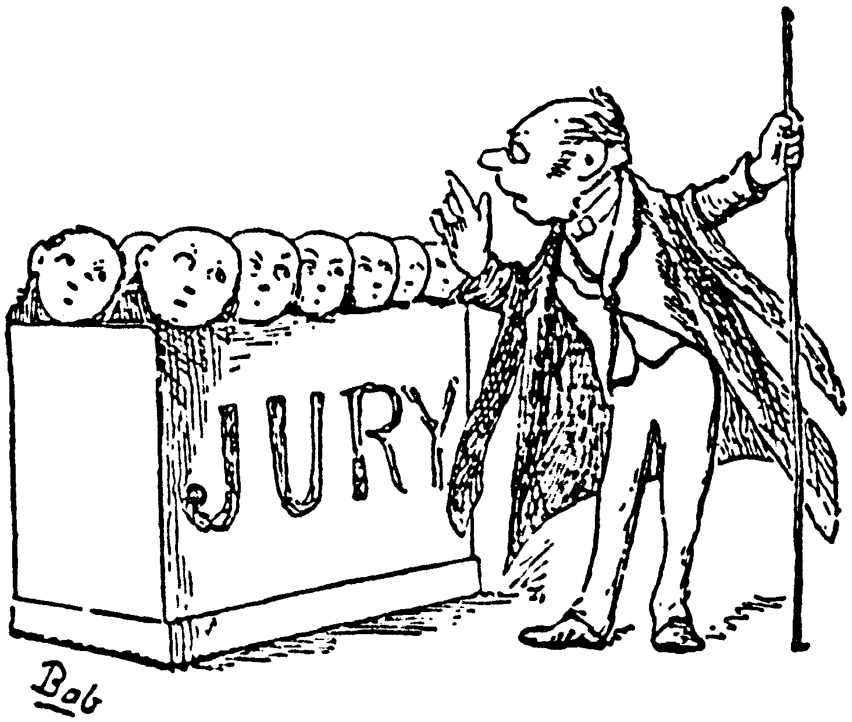
NOW… a detailed explanation of each step
Lets look at your handout…

Slide 6
OPENING STATEMENTS
The purpose of opening statements by each side is to tell jurors something about the case they will be hearing. The opening statements must be confined to facts that will be proved by the evidence, and cannot be argumentative.
The trial begins with the opening statement of the party with the burden of proof. This is the party that brought the case to court--the government in a criminal prosecution or the plaintiff in a civil case--and has to prove its case in order to prevail.

Slide 7
DIRECT EXAMINATION
Lawyers for the prosecution begin the presentation of evidence by calling witnesses . Direct examination may elicit both direct and circumstantial evidence. Witnesses may testify to matters of fact, and in some instances provide opinions. They also may be called to identify documents, pictures or other items introduced into evidence.
Generally witnesses cannot state opinions or give conclusions unless they are experts or are especially qualified to do so. Witnesses qualified in a particular field as expert witnesses may give their opinion based on the facts in evidence and may give the reason for that opinion.
Lawyers generally may not ask leading questions of their own witnesses. Leading questions are questions that suggest the answers desired, in effect prompting the witness. An example is, "Isn't it true that you saw John waiting across the street before his wife came home?"

Slide 8
DIRECT EXAMINATION - OBJECTIONS
Objections may be made by the opposing counsel for many reasons under the rules of evidence … (Lawyers will get a handout on examples of these)
Most courts require a specific legal reason be given for an objection. Usually, the judge will immediately either sustain or overrule the objection.
If the objection is sustained, the lawyer must re-phrase the question in a proper form or ask another question.
If the objection is overruled and the witness answers the question, the lawyer who raised the objection may appeal the judge's ruling after the trial is over.

Slide 9
CROSS EXAMINATION
When the lawyer Prosecution has finished questioning a witness, the lawyer for the defendant may then cross-examine the witness. Cross-examination is generally limited to questioning only on matters that were raised during direct examination.
Leading questions may be asked during cross-examination, since the purpose of cross-examination is to test the credibility of statements made during direct examination.

Slide 10
CLOSING STATEMENTS
The lawyers’ closing arguments discuss the evidence and properly drawn inferences. The lawyers cannot talk about issues outside the case or about evidence that was not presented.
The lawyer for the prosecution usually goes first. The lawyer sums up and comments on the evidence in the most favorable light for his or her side, showing how it proved what he or she had to prove to prevail in the case.
After that side has made its case, the defense then presents its closing arguments. The defense lawyer usually answers statements made in the plaintiff's or government’s argument, points out defects in their case and sums up the facts favorable to his/her client.

Slide 11
SENTENCING
If the defendant is convicted, the judge will set a date for sentencing. Before that time, a pre-sentence investigation will take place to help the judge determine the appropriate sentence from the range of possible sentences set out in the statutes. The pre-sentence investigation may consider the defendant's prior criminal record, family situation, health, work record, and any other relevant factor.
In most states and in the federal courts, only the judge determines the sentence to be imposed. (The main exception is that in most states juries impose sentence in cases where the death penalty is a possibility.) The federal courts and some states have sentencing guidelines to guide judges in determining appropriate sentences and to encourage uniformity.

