Slide 1
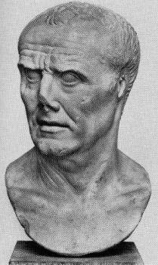
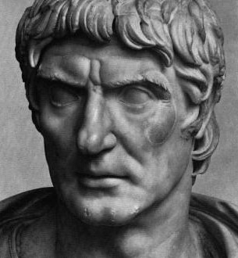
Fall of the Roman Republic
Armies became loyal to individual generals instead of Rome
Sulla
Marius
Rome was Broke
Needed to mistreat the plebeians more by taxing them
Aristocracy became more powerful
Senators gained too much power and did more political actions without the consent of the Consuls

Slide 2
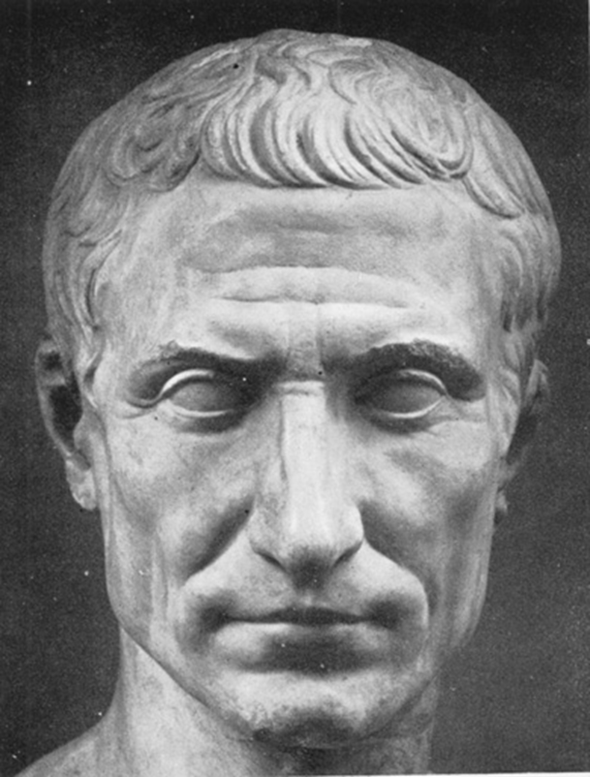
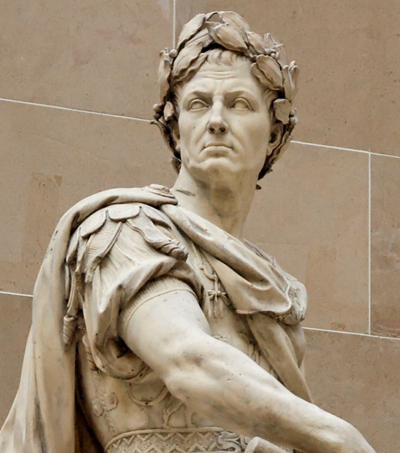
Rise of Julius Caesar
He was a Patrician that was very Wealthy
Very Ambitious and willing to take any job to gain power
He believed that he was destined to become a leader
Became 1 of the 3 men who made up the First Triumvirate
Caesar, Crassus and Pompey 59 BC – 53 BC
Became one of the greatest military leaders of all time
Lead Rome’s conquest in Gaul in the Gallic Wars
59 BC – 49 BC

Slide 3
Height of Julius Caesar
Marched on Rome 49 BC
Crossed the Rubicon River, declaring war on Rome
“The Die is Cast”
Engaged in a Civil War with Pompey from 49 BC – 46 BC
Pompey was killed by Egyptians who tricked him into coming ashore, only to attack him and cut off his head
The Egyptians presented the head to Caesar who was angry that his friend/rival was killed by someone other than him!
“THE DIE IS CAST”

Slide 4
SOCIAL REFORMS:
Organized the Calendar
Fixed the tax system (allowing the Plebeians to pay less)
Reorganized the political structure (shrunk the number of members in the Senate)
Provided food and housing for the poor
Increased public education
Caesar won the Civil War
Elected Dictator for life
Instituted political and social reforms – making Rome more efficient
Made the Plebeians happy
Made the aristocrats mad
Fellow patricians felt that Caesar was weakening their power

Slide 5
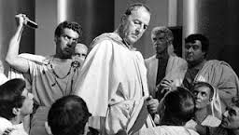
Downfall of Julius Caesar
Was declared dictator for a 10 – year period in 46 BC
In early 44 BC was named “Dictator in Perpetuo” (Dictator for life)
This led to a conspiracy plot by more than 60 Senators
The Senators felt they were Saving the Republic
March 15th 44 BC (“Ides of March”) – Caesar was stabbed to death 23 times by fellow Senators in the Theater of Pompey
Brutus (possible illegitimate son – and former ally) was leading the conspiracy!
When he realized that it was Brutus he (supposedly) said “Et tu Brute?” (and also you Brutus?)
This assassination created Chaos in the Republic

Slide 6
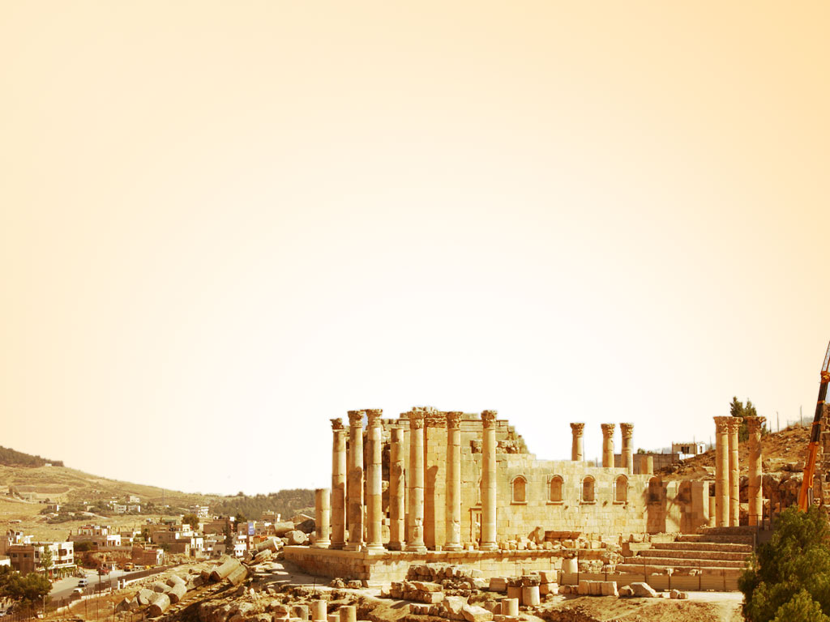
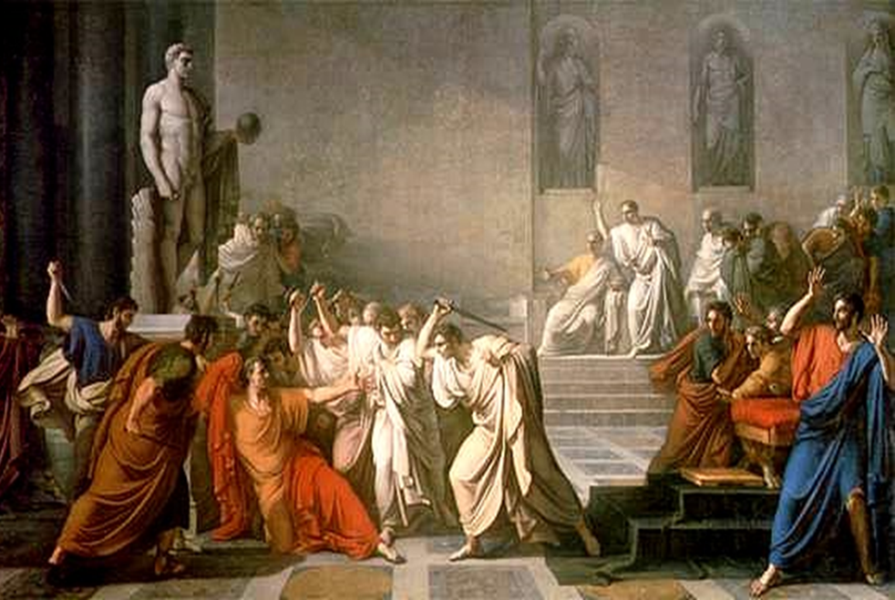
Assassination of Caesar – by Vincenzo CAMUCCINI
When Caesar realized that he was being attacked, he used his stylist (his pen) to stab back; when he realized that there were too many attackers, he throw his toga over his face so that no one would see him die
When Caesar realized that he was being attacked, he used his stylist (his pen) to stab back; when he realized that there were too many attackers, he throw his toga over his face so that no one would see him die

Slide 7
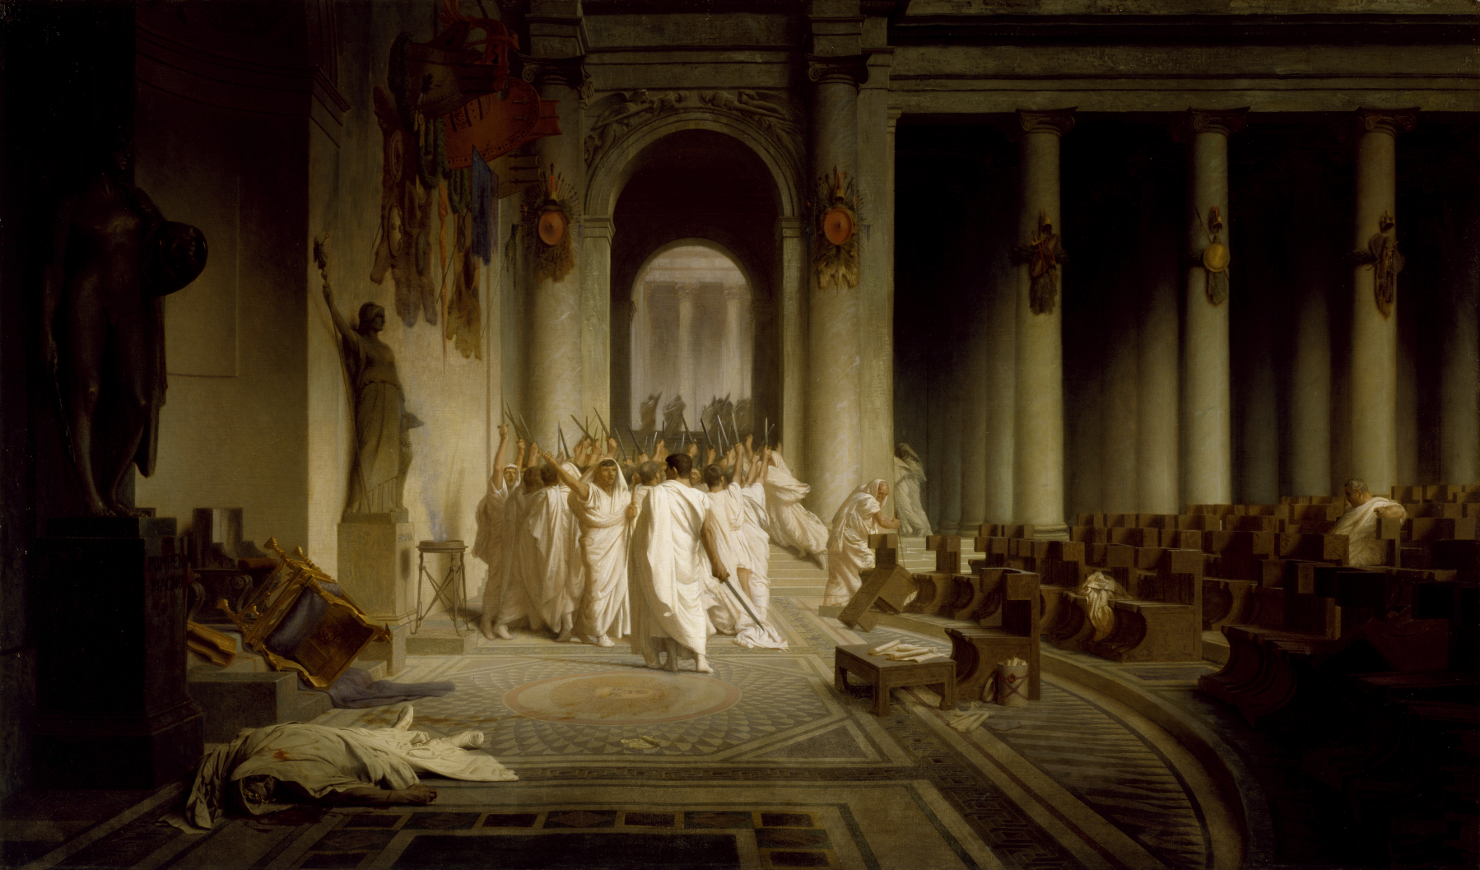
Assassination of Caesar – by Jean-Léon_Gérôme
The assassins believed they saved the Republic, and although they were protected from going to jail, they were hated around the empire, and had to settle in outlaying countries like Greece for the remainder of their lives.

Slide 8
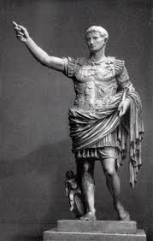
Rise of the Roman Empire
Who would you follow?
Octavian was the true heir of Caesar – named in his will to be his successor
Mark antony was Caesar’s buddy and fellow soldier throughout his various campaigns – especially in gaul
Caesar named his great nephew, Octavian as his heir in his will
Octavian was a only 20 at the time, and a very fragile person, who had never been engaged in the military
Caesar knew him, and recognized his leadership capabilities
Caesar’s “Master of the Horse” – lead General Mark Antony expected to be named the heir to Caesar, and became upset after he found that he was not named
Octavian entered into a struggle for power with Antony
Octavian chased Antony to the Egyptian empire
(now under Roman rule) where Antony had
‘married’ Queen Cleopatra IV
Antony and Cleopatra committed suicide,
giving Octavian sole power of the Roman Empire
Second in command – his ‘right hand man’

Slide 9
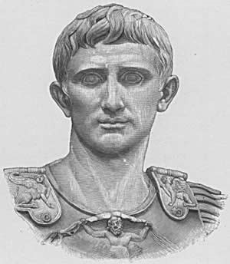
Effect of the Roman Empire
Octavian named himself Augustus or Exalted One, and named himself Princeps or first citizen – not King or dictator!
He became Caesar (creating the title in honor of Julius) in 31 BC and began ruling Rome like a King, but without the tyranny that comes along with a single ruler
Augustus ruled until 14 AD
He started the Pax Romana – or Roman Peace that lasted 200 years
This new type of leadership in Rome lasted for another 450 years.

Slide 10
Ironies of the Roman Empire
Julius Caesar was murdered in order to Preserve the Roman Republic, but in effect, it created a new monarchy or dictatorship.
Caesar was known to many as a shrewd business man, others as a military general and still others as a vain, greedy man – but in his death, he became a GOD to the Romans.
Caesar’s life became a model of Romans that were trying to achieve – his ambitions symbolized the Roman Empire

Slide 11
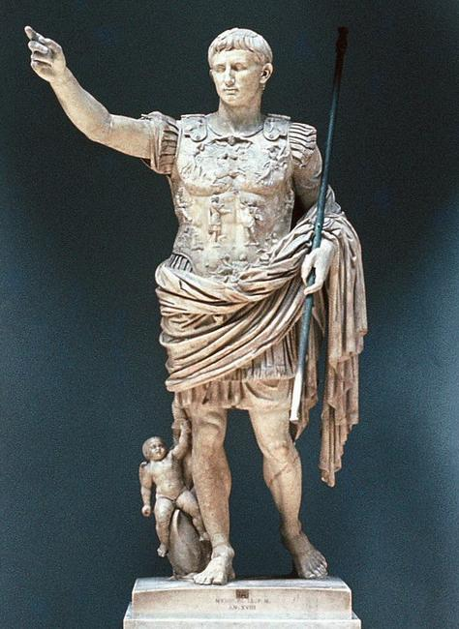
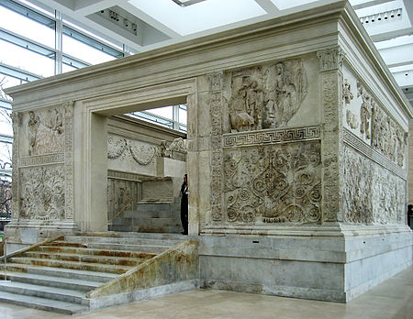
Augustus becomes the sole ruler of Rome in 31 BC after defeating Mark Antony in a Civil War.
Augustus rules for 45 years, starting the Roman Pax Romana – 200 years of Peace
Augustus’ government reforms set the Empire up to last for 400 more years
The Roman Empire

Slide 12
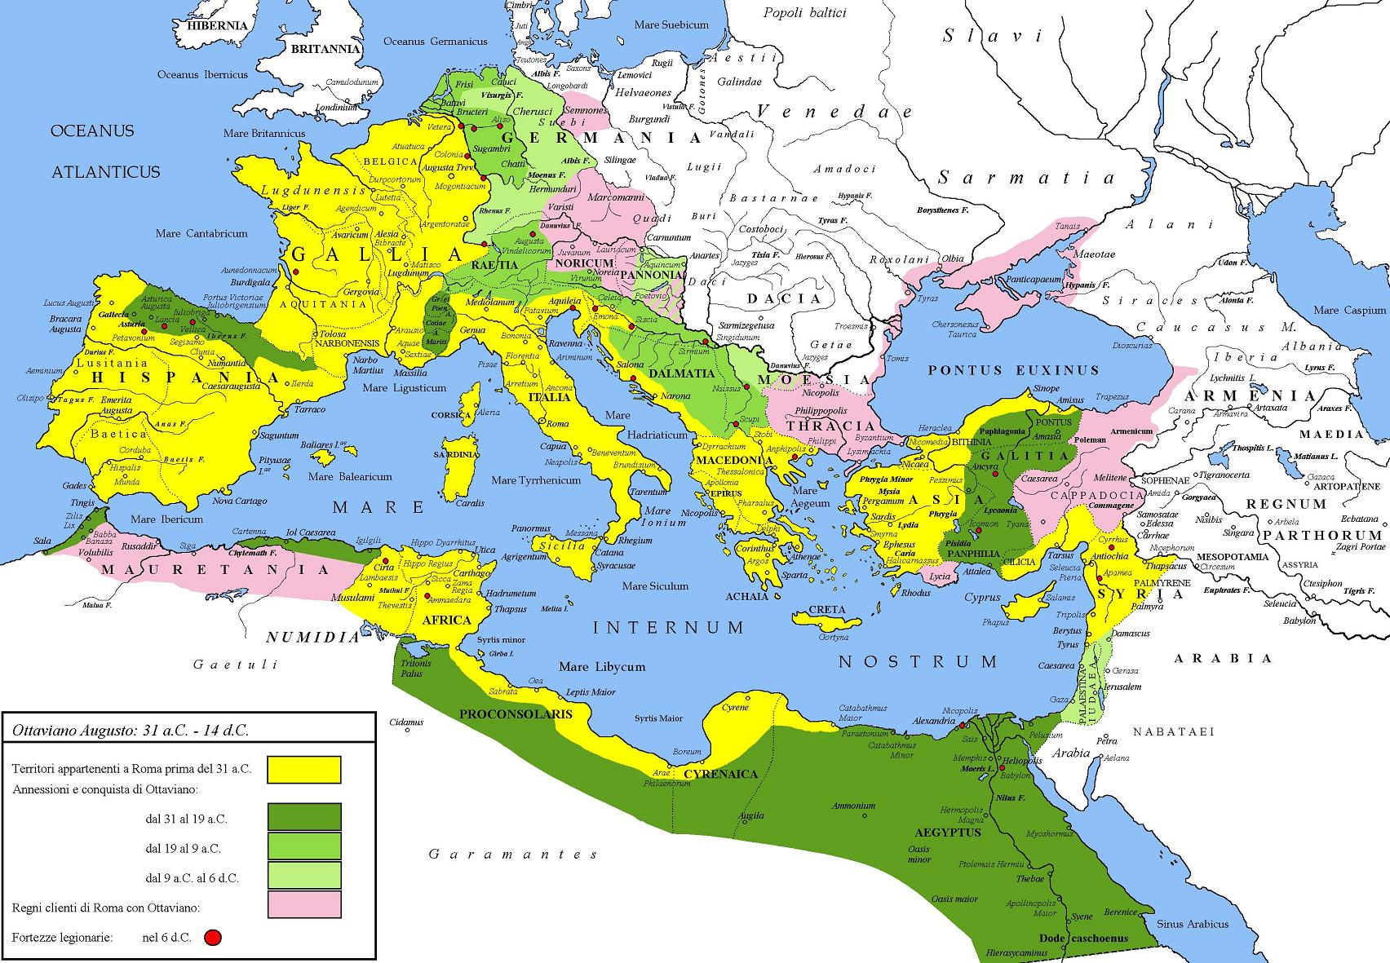
Augustus extended the empire further than any other ruler or consul before him.
He fought constant wars on all fronts of the empire

Slide 13
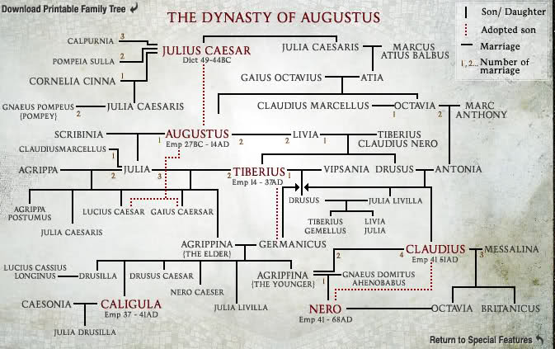
The Roman Empire
The major problem with the Empire was the succession of the next ruler.
Many Roman Caesars were terrible, but could not be voted out

