Slide 1
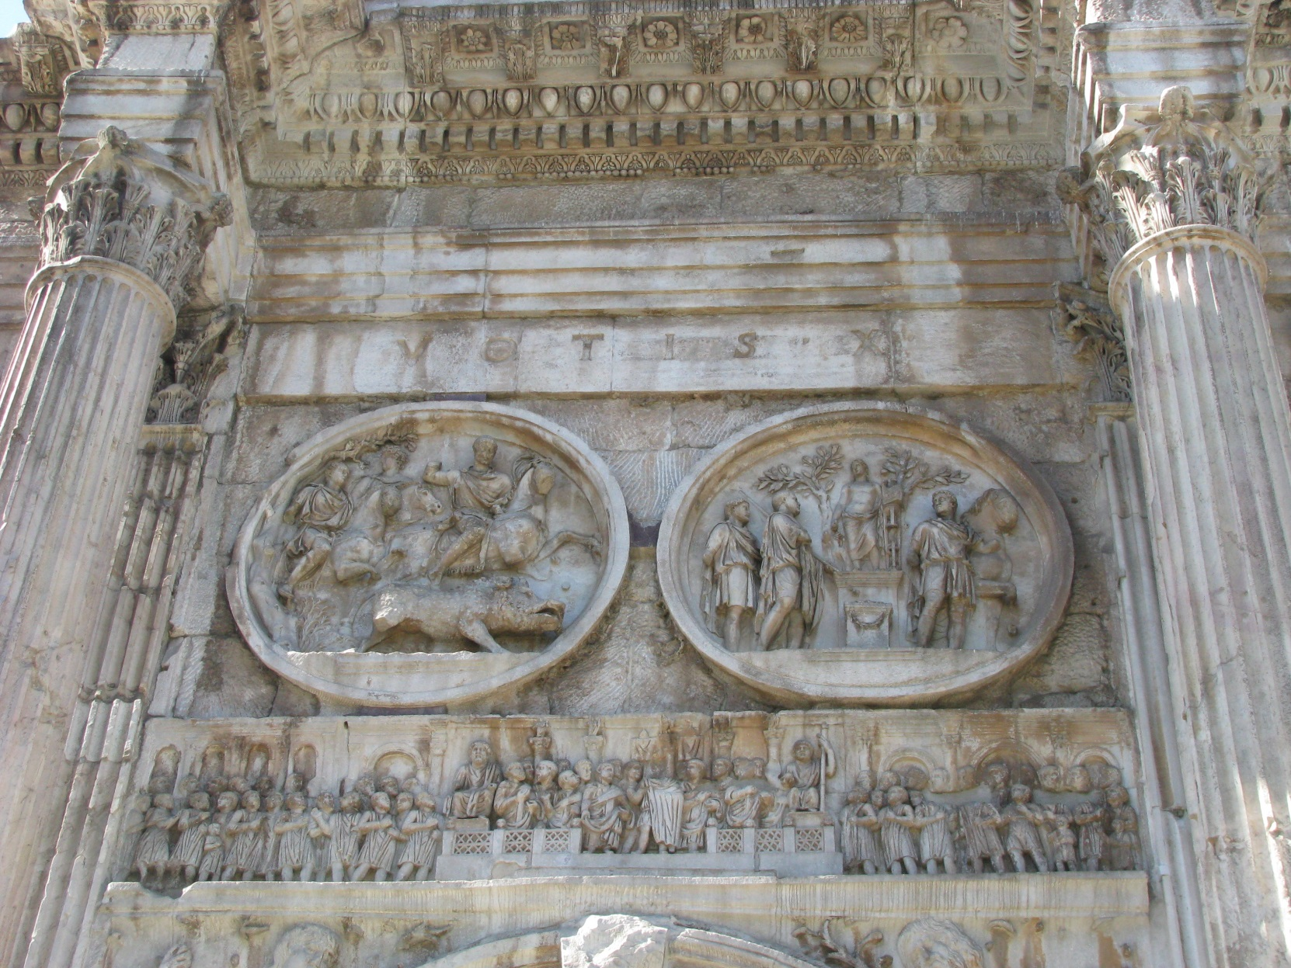
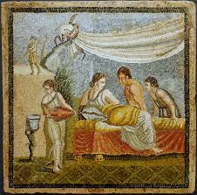
iv.The Culture of Ancient Rome
Romans used sculpture to express symbols of power and leadership!
Mosaic was also a form of art that was created by the Romans.
Mosaic is a picture made from chips of colored stone or glass

Slide 2
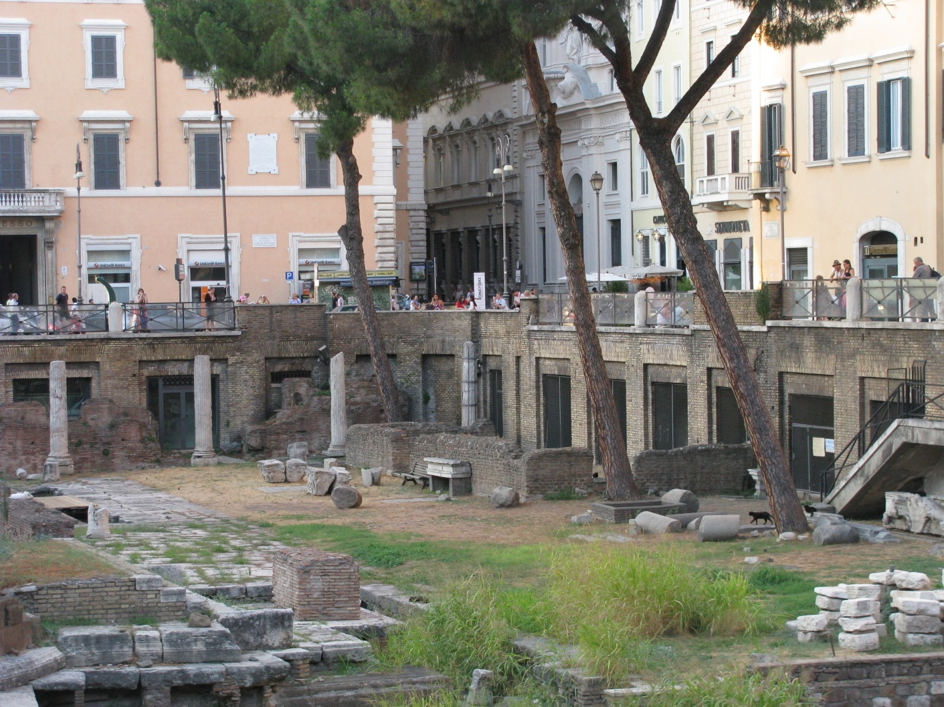
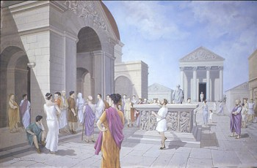
The Culture of Ancient Rome
iv.The Culture of Ancient Rome
Like Greek agoras, Roman cities had a forum for markets & public gatherings
Area sacra – a market off the main road – Via Sacra

Slide 3
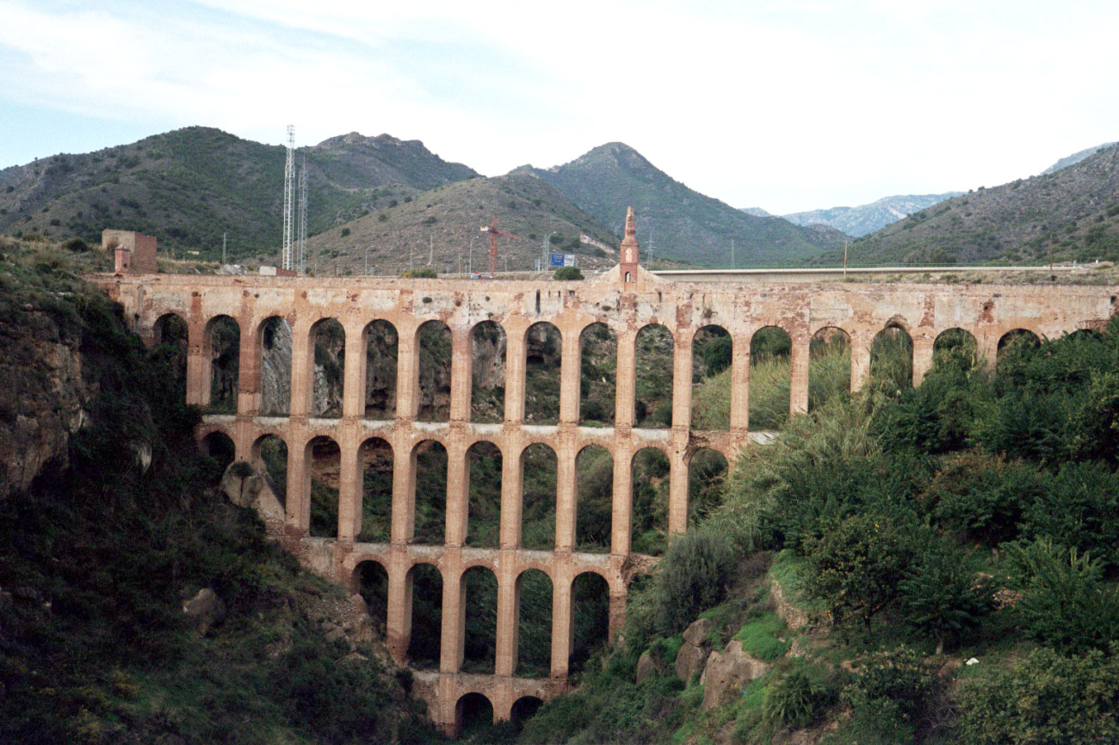
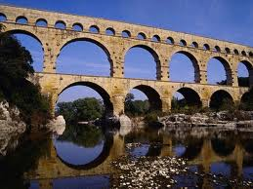
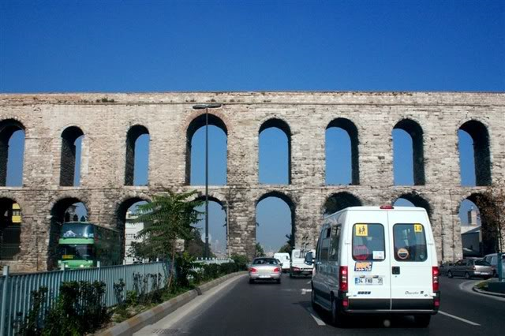
iv.The Culture of Ancient Rome
Romans built aqueducts that carried water from hills into Roman cities.
Romans excelled in engineering.
They build roads, bridges, and harbors.
https://youtu.be/K04DWasCnh0

Slide 4
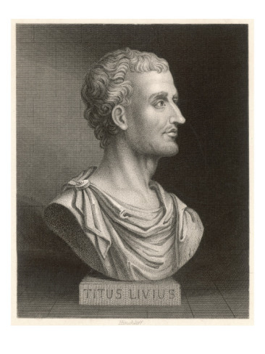
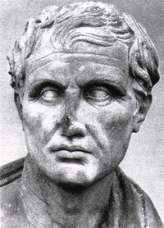
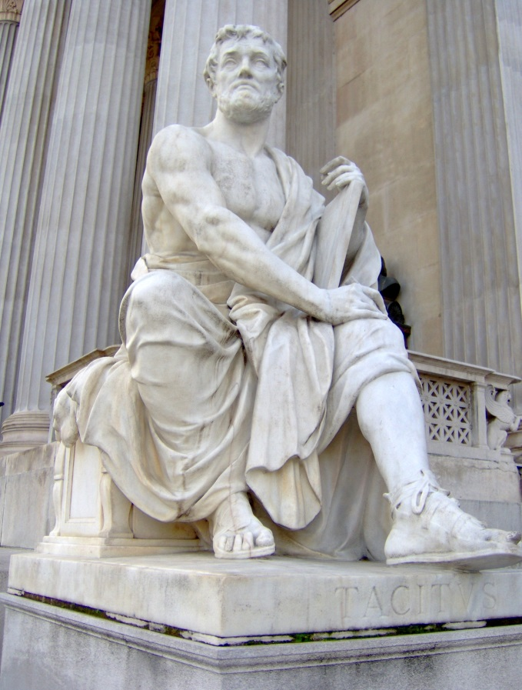
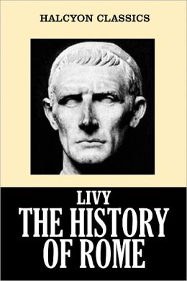
Iv .The Culture of Ancient Rome - literature
Virgil was a Roman poet who wrote The Aeneid
Tacitus was a historian whose two major works were the Annals and the Histories
Livy was a Roman historian who wrote patriotic stories of the greatness of Rome

Slide 5
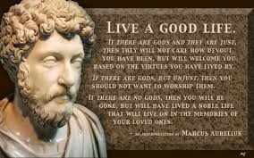
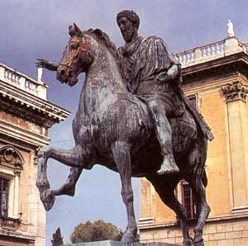
Iv .The Culture of Ancient Rome
Marcus Aurelius was a Roman Caesar (Emperor) and philosopher who wrote Meditations
he was a Stoic – stressing the importance of duty and concern for the well-being of all people

Slide 6
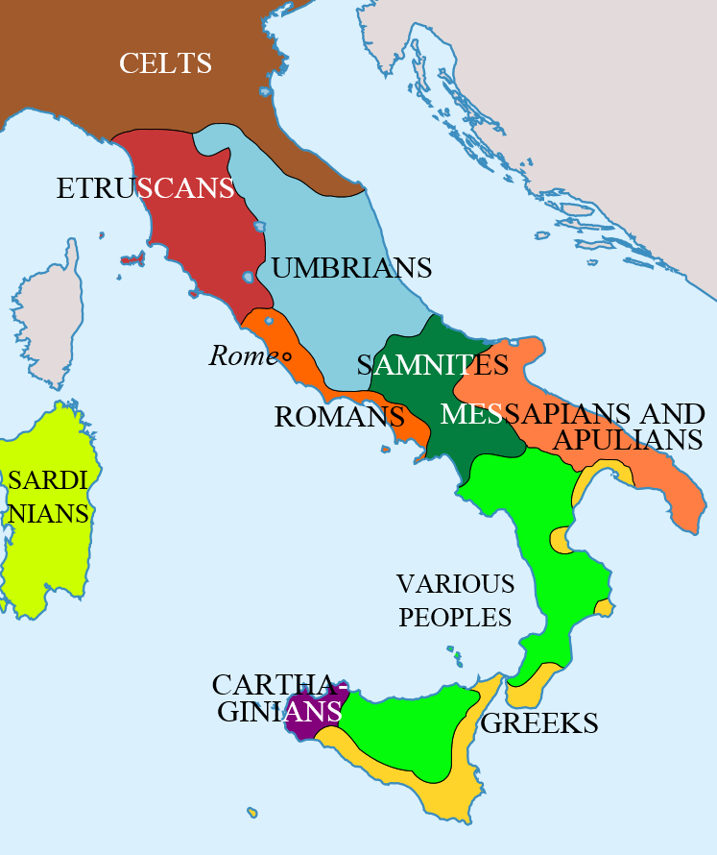

Slide 7
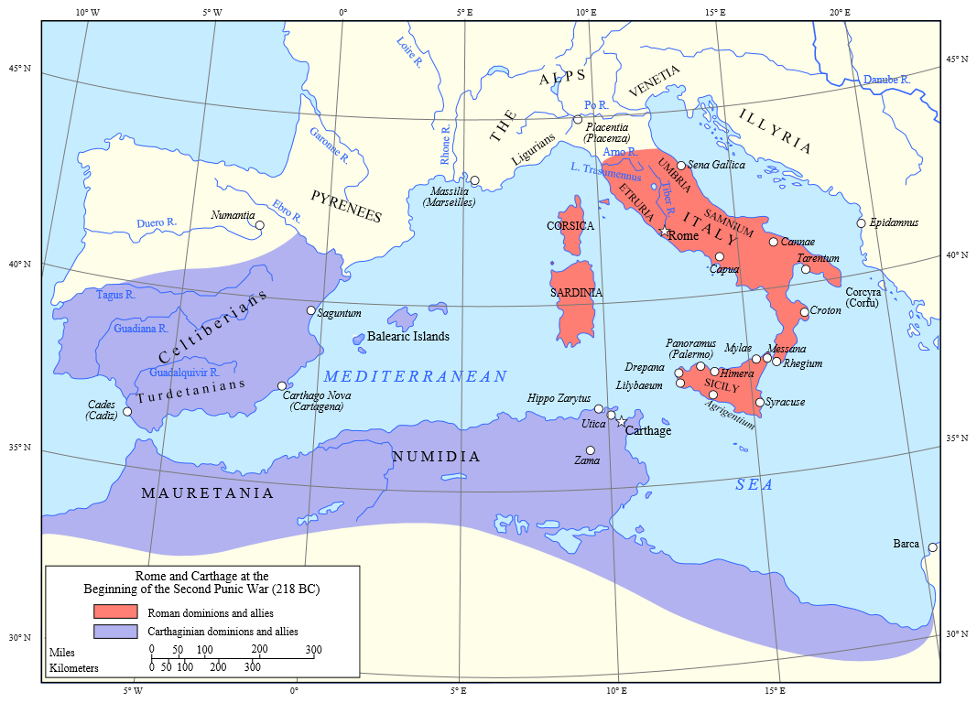

Slide 8
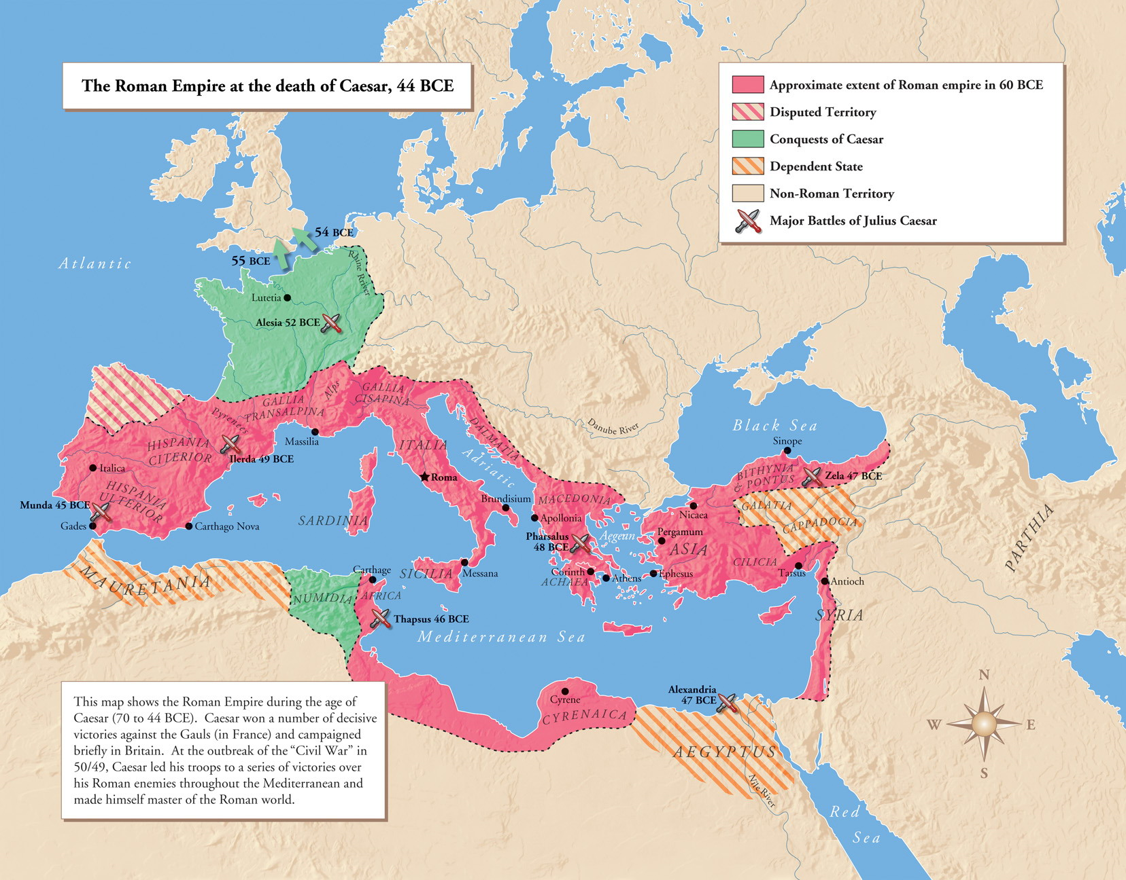

Slide 9
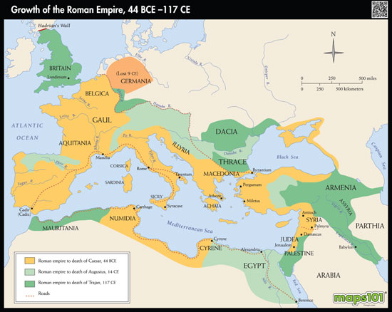

Slide 10
GROWTH OF ROME
How did Rome grow so big and cover so much area?
They were able to move quickly, govern efficiently and maintain order with an incredible military
Why did Rome want to get so big?
The bigger an empire, the more money it makes. Rome wanted to become so powerful that no other force could rise up and defeat her.
How did Rome’s lust for expansion eventually lead to the downfall?
The empire was too big to govern and almost impossible to maintain order.

Slide 11
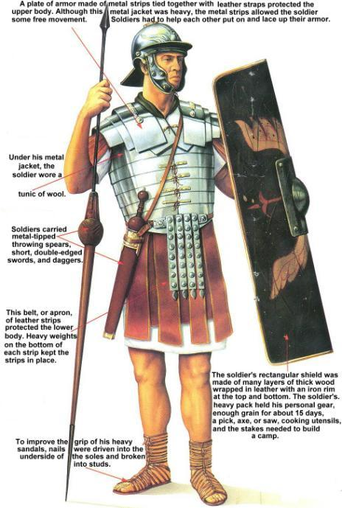
The Roman Military
Rome was protected by an advanced army that was divided into groups of 5,000 soldiers called legions
Each legion was divided into smaller groups of 80 men called a century
Notes:
The Roman Army In addition to their government, the Romans placed great
value on their military. All citizens who owned land were required to serve in the
army. Seekers of certain public offices had to perform ten years of military service.
Roman soldiers were organized into large military units called legions. The
Roman legion was made up of some 5,000 heavily armed foot soldiers (infantry).
A group of soldiers on horseback (cavalry) supported each legion. Legions were
divided into smaller groups of 80 men, each of which was called a century. The
military organization and fighting skill of the Roman army were key factors in
Rome’s rise to greatness.

Slide 12
