Slide 1
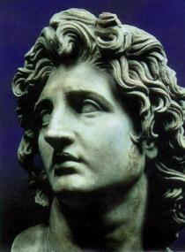
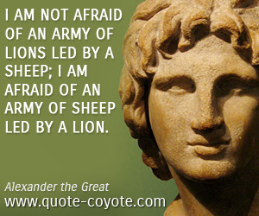
V. ALEXANDER THE GREAT

Slide 2
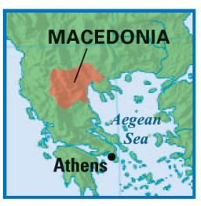
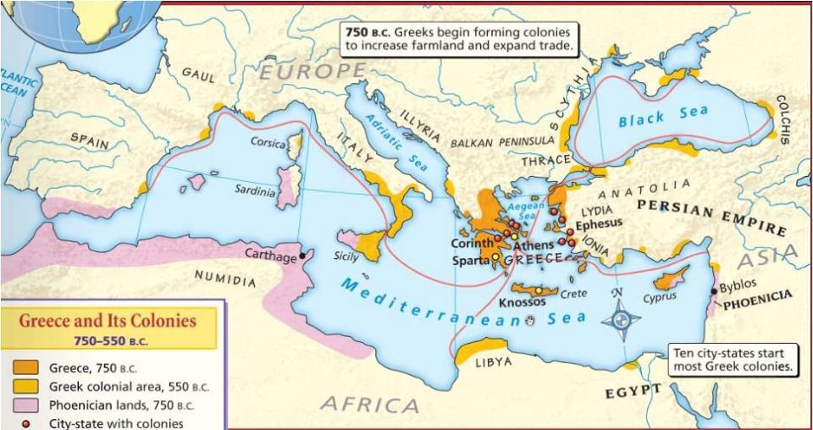
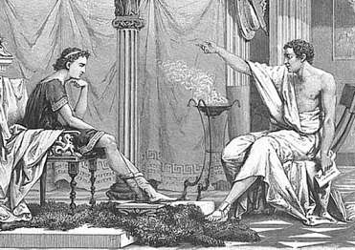
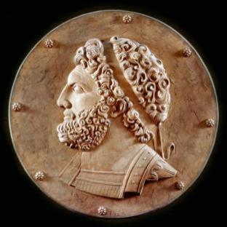
V. ALEXANDER THE GREAT
In 338 B.C., King Philip II of Macedonia attacked & conquered the Greeks, but he died soon after
Macedonians viewed themselves as Greeks & shared much of their culture; King Philip II hired Aristotle to tutor his son Alexander

Slide 3
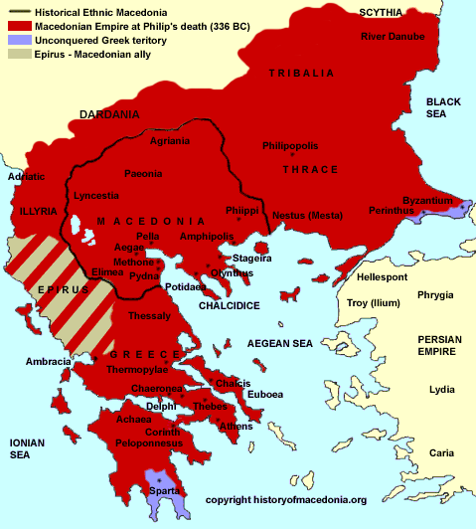
V. ALEXANDER THE GREAT
II. Rise of Alexander
Alexander was only 20 years old when he became king of Macedonia:
But he proved to be ambitious & a brilliant Military strategist once in power, Alexander began to expand his empire

Slide 4
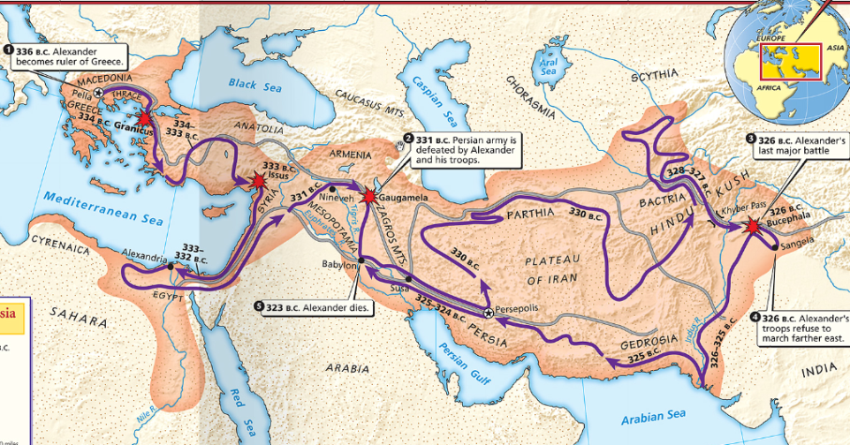
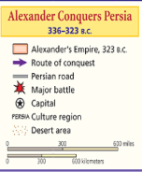
Alexander began his conquest by crushing a Greek revolt in Thebes; He ordered the death of 6,000 people & sold everyone else into slavery; His brutality convinced other Greeks to not rebel
V. ALEXANDER THE GREAT
Alexander set his sights on the Persian Empire & began his attack by conquering Egypt; Egyptians viewed Alexander as a liberator

Slide 5
In 331 B.C., Alexander attacked & defeated the mighty Persian army led by King Darius III
Alexander destroyed the capital of Persepolis
V. ALEXANDER THE GREAT
https://youtu.be/VsnVi1Gid_I
Battle of Gaugamela
Alexander led his army to conquer India; After taking the Indus River Valley, Alexander’s troops begged him to return home after 11 years away from their homes while conquering the empire

Slide 6
V. ALEXANDER THE GREAT
By 323 B.C., Alexander had conquered a massive empire & began plans to govern & unify his kingdom, but he fell ill & died at the age of 32 in Babylon.

Slide 7
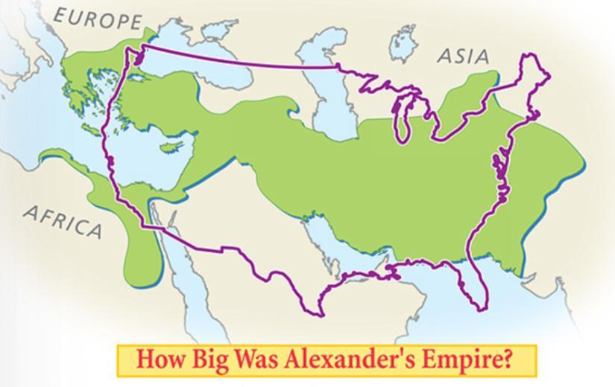
Wider than the United States!
Alexander and his army walked for over 10 years!
Don’t complain that you have to walk from the science hall to my room!!

Slide 8
V. ALEXANDER THE GREAT
Alexander left behind an important legacy: He spread Hellenic (Greek) innovations & culture throughout his empire
Hellenism is the spread & blending of Greek culture
In each territory he conquered, Alexander left behind a Greek-styled city named Alexandria

Slide 9
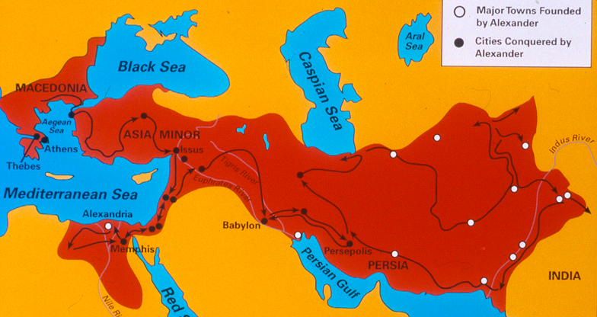
Alexandria in Egypt was the most significant of these cities & best represented Hellenism
V. ALEXANDER THE GREAT
Alexandria became the center for Hellenistic culture & trade for the Mediterranean world
Alexandria had a museum & library that preserved Greek, Egyptian, Persian, Indian cultures & attracted scholars for centuries

Slide 10
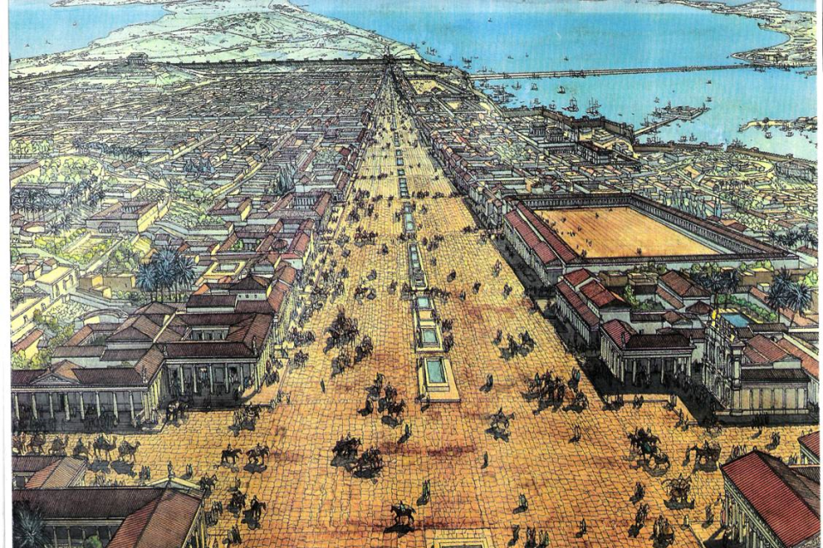
Alexandria, Egypt

Slide 11
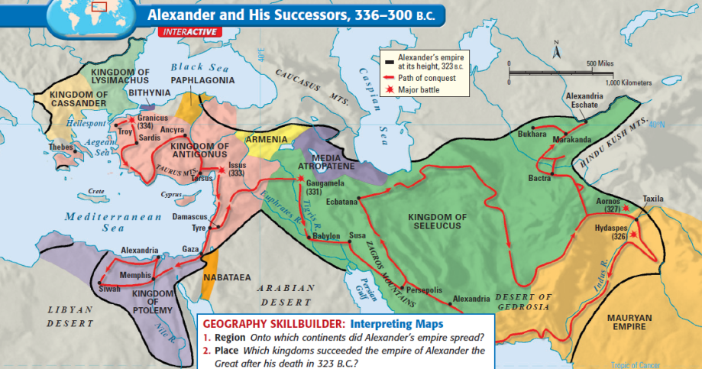
V. ALEXANDER THE GREAT
Alexander's empire was the largest of the classical era, but it was short-lived (13 years) & was never unified or governed
When Alexander died without an heir, his empire was divided among his top 3 generals
1
2
3

Slide 12
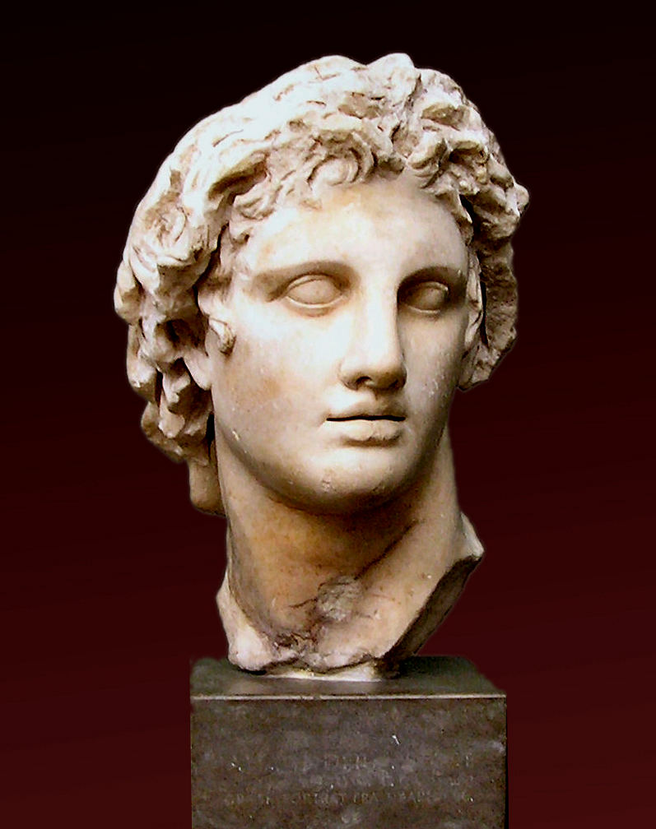
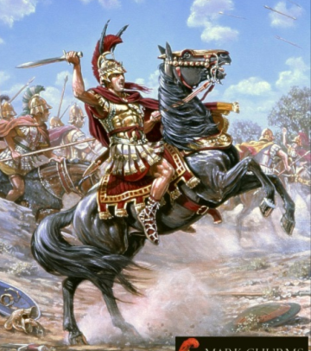
V. ALEXANDER THE GREAT
conclusion
He was a military genius & well educated
His interest in Greek history & culture as well as Persian, Egyptian, & Indian ideas led to a vibrant new culture, Hellenism, that shaped future civilizations

