Slide 1
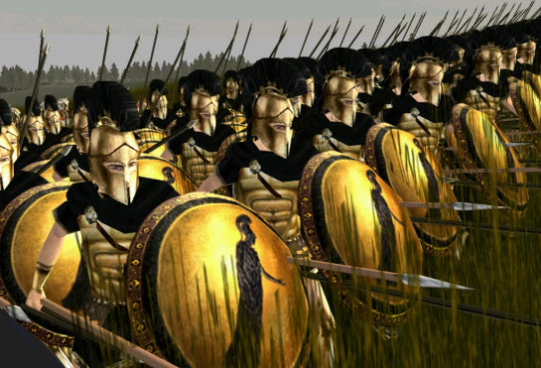
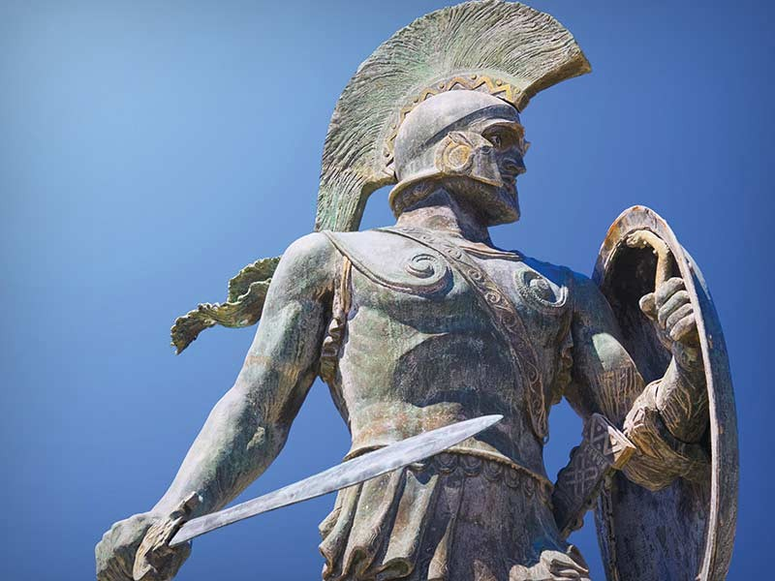
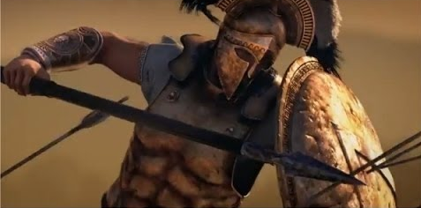
III. CONFLICT AND WAR IN GREECE

Slide 2
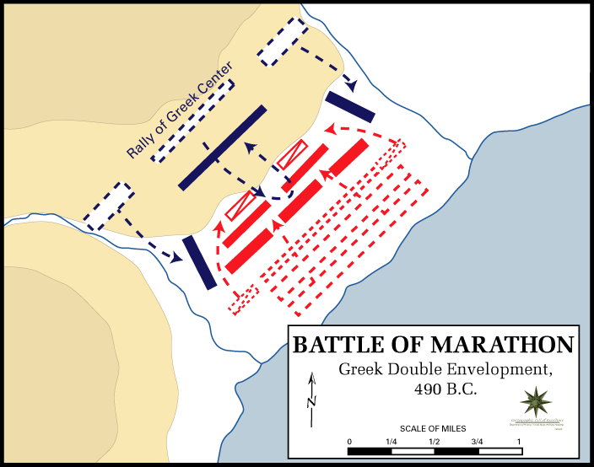
III. CONFLICT AND WAR IN GREECE
PERSIAN WAR
Persia attempted an invasion In 490 B.C. on the Greek City-States
Persian king Darius I attempted to invade as part of the First Persian War, but a combined Greek force (Sparta and Athens) turned back the Persian army at the Battle of Marathon.

Slide 3
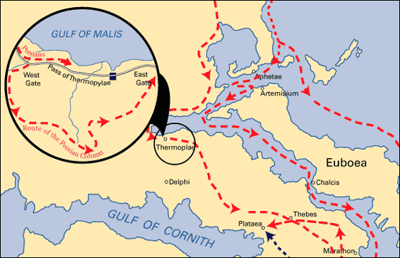
III. CONFLICT AND WAR IN GREECE
Ten years later, during the Second Persian War, one of Darius’ sons, Xerxes again launched an invasion against Greece
Battle of Thermopylae - Leonidas established his army at Thermopylae, at a narrow pass that would funnel the Persian army.
For two days, the Greeks withstood the determined attacks of their far more numerous enemy
Persians found a route over the mountains to the west of Thermopylae that would allow the enemy to bypass the Greek army and surround them.
PERSIAN WAR

Slide 4
PERSIAN WAR - Battle of Thermopylae

Slide 5
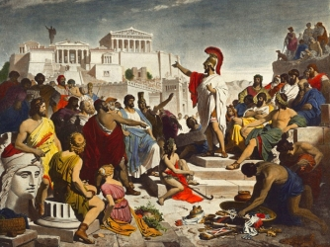
III. CONFLICT AND WAR IN GREECE
PELOPONNESIAN WAR
Athens and Sparta fought together in the Greco-Persian Wars between 499 and 449 B.C.
After that victory, Athens grew more powerful and tensions rose, turning into nearly 30 years of war.
Sparta emerged victorious, while the constant fighting left Athens bankrupt, exhausted and discouraged.
Neither city-state regained the military strength they once had.

Slide 6
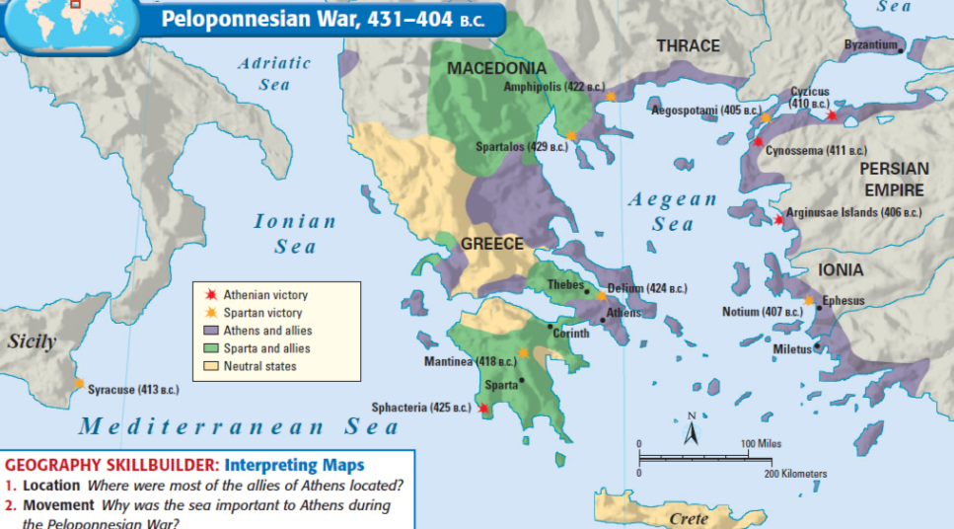
PELOPONNESIAN WAR
Athenian victories
Spartan victories

Slide 7
PELOPONNESIAN WAR

Slide 8
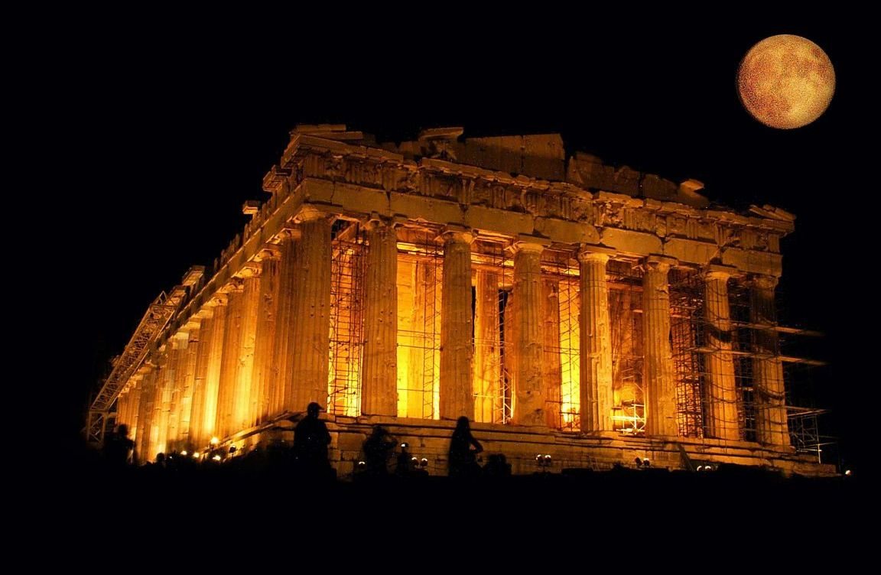
IV. GLORY OF GREECE
IV. GLORY OF GREECE

Slide 9
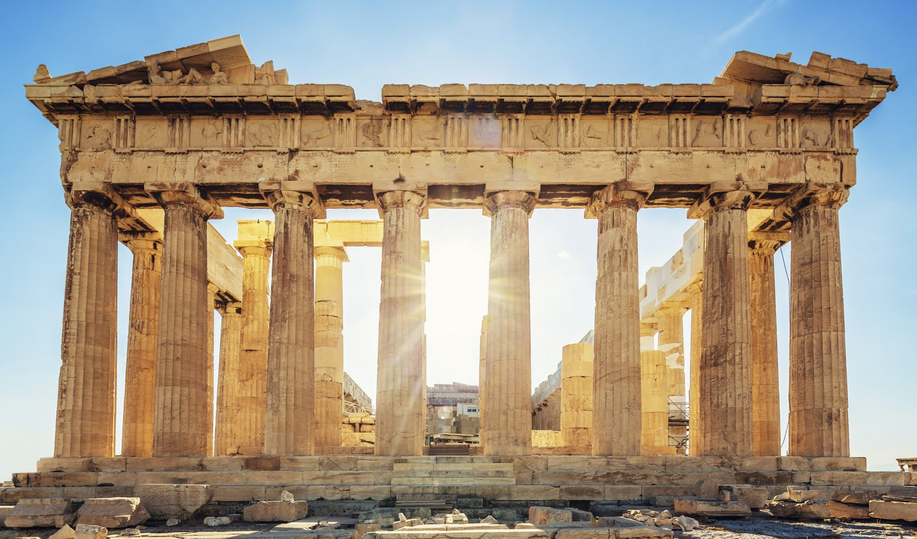
IV. GLORY OF GREECE
The ancient Greeks made contributions in many fields of learning & developed new innovations:
The Greeks emphasized education & the pursuit of knowledge
Many Greeks could afford to support academies & centers of learning
Greece’s location along the Mediterranean Sea allowed for trade, the spread of diverse ideas, & the ability to build n achievements from other parts of the ancient world

Slide 10
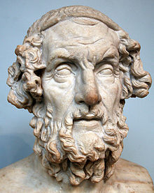
GREEK LITERATURE / DRAMA
IV. GLORY OF GREECE
Homer, the poet wrote the famous stories of The Odyssey and The Iliad, which are read in Language Arts classes all over the world.
Drama was also important to the ancient Greeks. They were the first to develop comedies and tragedies.
Theaters were built that were open-air and built in a way that everyone in the audience could hear and see the action.

Slide 11
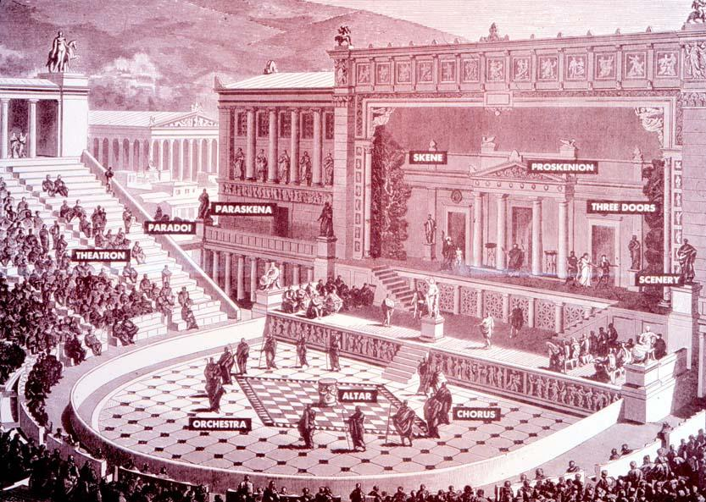
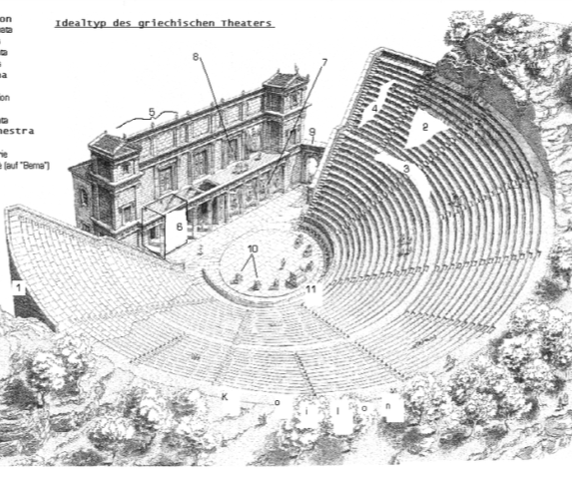
IV. GLORY OF GREECE
Examine the images and answer these questions:
How does the seating arrangement in theater make it easy for the audience to see & hear what is happening?
Why would it be important for actors to wear large masks and colorful costumes?
GREEK LITERATURE / DRAMA

Slide 12
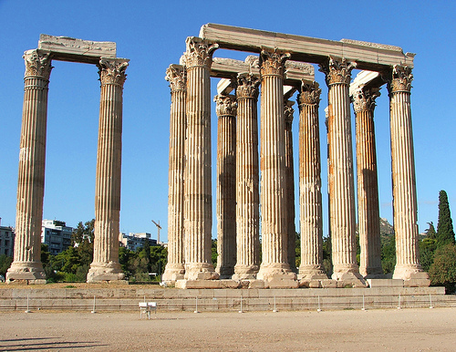
III. Greek Architecture
IV. GLORY OF GREECE
The Greeks were among the most talented architects of the ancient world
The Parthenon, a temple made of marble in honor of the goddess Athena, is probably one of the most famous examples of Greek architecture.
The Greeks used columns (Doric, Ionic and Corinthian) & displayed murals of mythological scenes in their buildings.

Slide 13
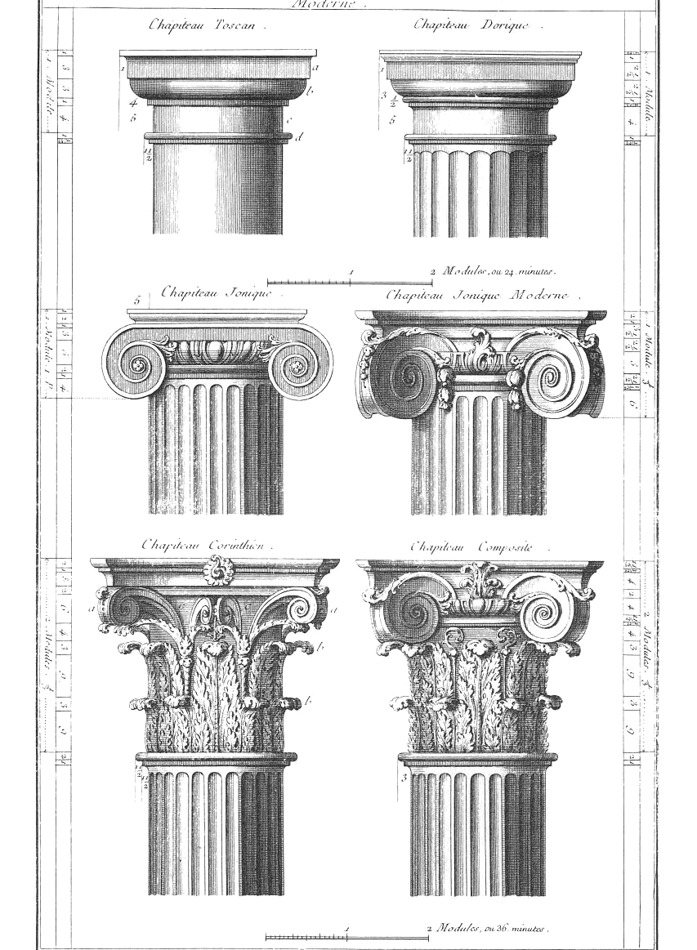
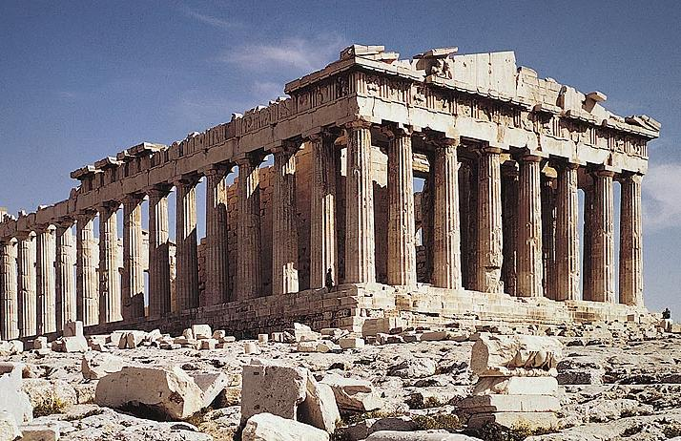
III. Greek Architecture
IV. GLORY OF GREECE
Which column do you think is the best style? Make a sketch of that style in the activity box of your notes for this station

Slide 14
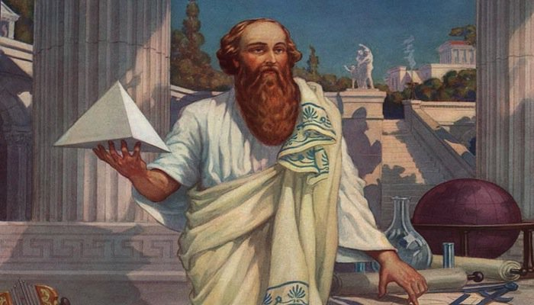
Greek Mathematics
IV. GLORY OF GREECE
Ancient Greek mathematicians developed many important concepts that are still
used today. Scientists used pi to find circumference of circles.
Euclid developed proofs that became
the basis for modern geometry
Pythagoras tried to explain everything in mathematical terms. He created a theorem about relationships of sides of right triangle that is used all over the world called the Pythagorean Theorem

Slide 15
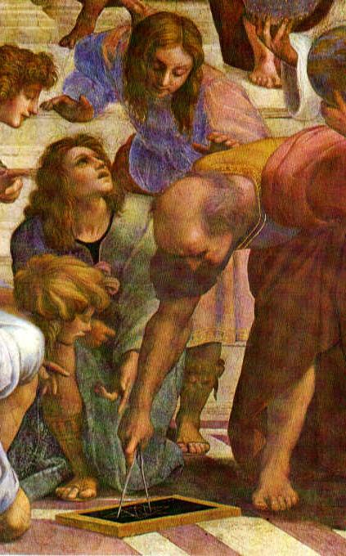
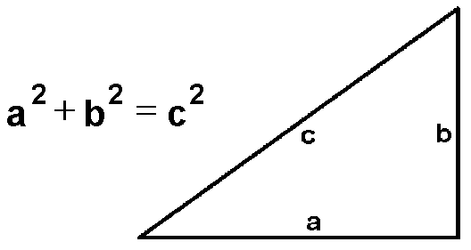
IV. GLORY OF GREECE
Use the Pythagorian Theroum to solve for “c”.
The value of “a” is 3 and
“b” is 6
Greek Mathematics

Slide 16
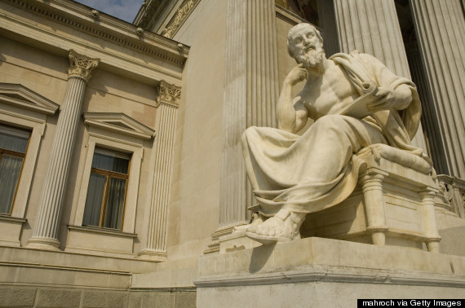
Greek Philosophy
IV. GLORY OF GREECE
Philosophy means “love of wisdom”
Socrates taught students to challenged accepted values in Greece. He thought people must think for themselves to understand truth
Aristotle created the basis for the scientific method (every truths is followed by other logical truths)

Slide 17
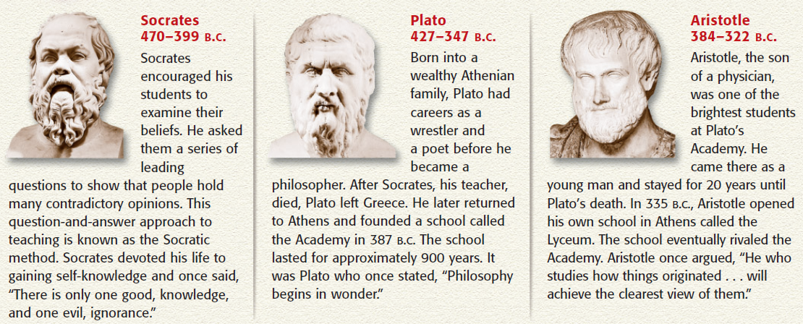
IV. GLORY OF GREECE
V. Greek Philosophy

Slide 18
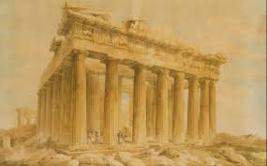
PLATO

Slide 19
ARISTOTLE

Slide 20
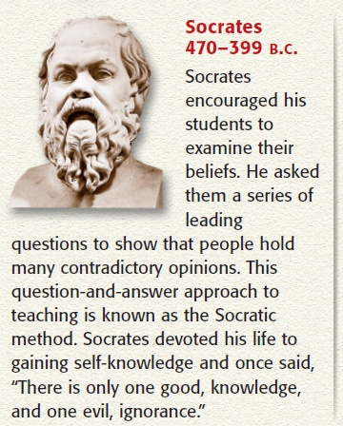
IV. GLORY OF GREECE
Answer the following:
Do you think that questioning is a good way of learning?
Is there such a thing as too many questions? Why or why not?
Greek Philosophy
“As for me, all I know is that I know nothing.” —Socrates

Slide 21
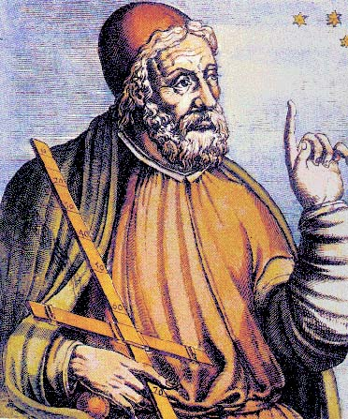
VI. Greek Astronomy & Geography
IV. GLORY OF GREECE
Greek concluded that the sun was larger than earth (they had thought it was smaller than Greece).
While they debated if the sun or the earth was the center of the universe, the astronomer Ptolemy thought that the earth was the center (geocentric) and this would be believed for 14 centuries.
The Greeks were able to determined earth’s true size.

Slide 22
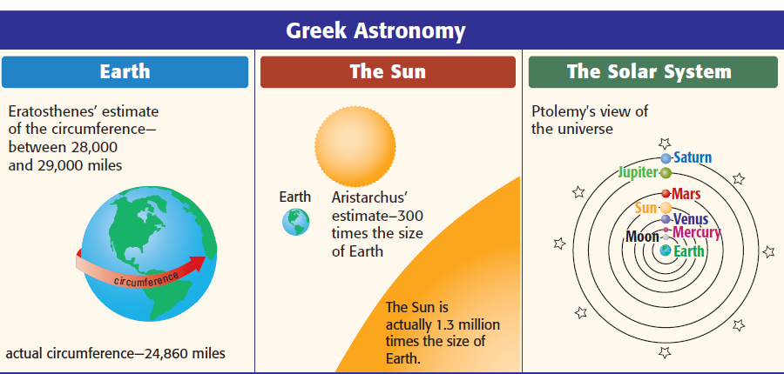
IV. GLORY OF GREECE
Which contribution of the Greeks to astronomy and geography do you think is the MOST important? Make a sketch to represent that idea.
VI. Greek Astronomy & Geography

Slide 23
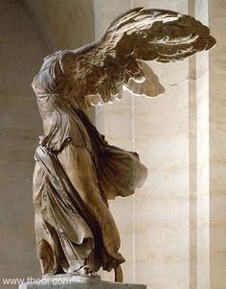
Greek Sculpture
IV. GLORY OF GREECE
The Greeks began carving life-size statues very early on. Greek sculpture was innovative by showing realism & human movement
Greek artists tried to show “ideal human beauty” which often was represented by nude sculptures

Slide 24
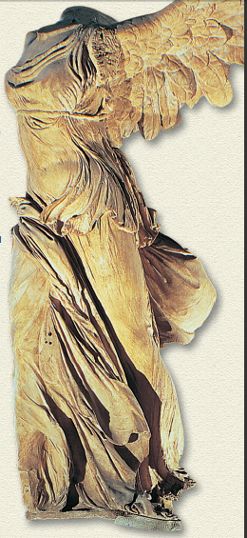
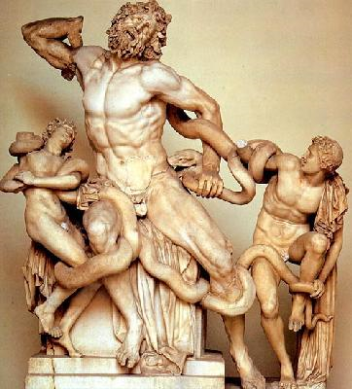
IV. GLORY OF GREECE
Answer the following questions:
Why do you think that these and other Greek statutes are considered to be works of art?
What makes them different
from other art that you have
seen?
Greek Sculpture

Slide 25
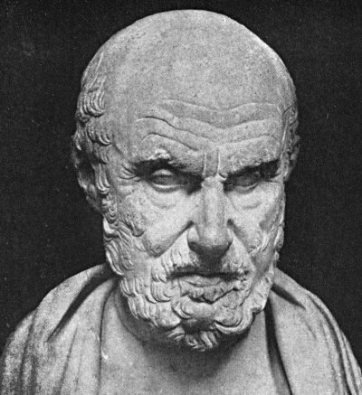
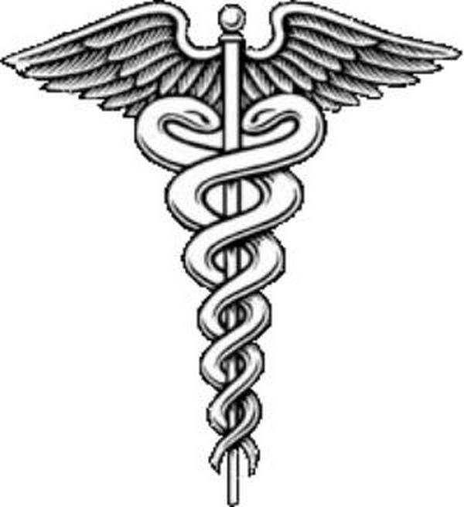
Greek Medicine
IV. GLORY OF GREECE
Hippocrates is called the “father of modern medicine” because he began a school that introduced new medical teachings and practices.
Hippocrates believed that disease was caused by natural events not by the gods.
The Greeks developed the Hippocratic Oath, a pledge that doctors take that emphasizes doctor’s responsibility for their patients.

Slide 26
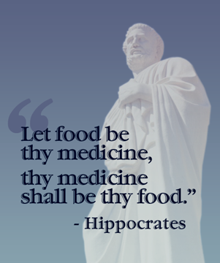
IV. GLORY OF GREECE
Answer the following questions:
What part of the excerpt from the Hippocratic Oath stands out the most to you?
What are doctors promising?
Summarize the quote in a short phrase.
“I swear by Apollo, the healer, and I take to witness all the gods…the following Oath: I will prescribe regimens for the good of my patients according to my ability and my judgment and never do harm to anyone.”—Excerpt from the Hippocratic Oath
Greek Medicine

Slide 27
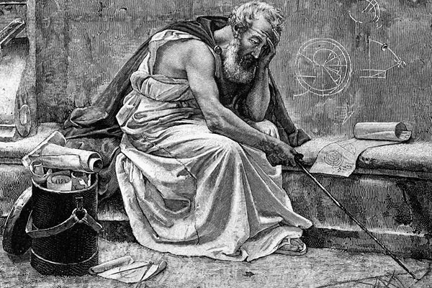
Greek Engineering
IV. GLORY OF GREECE
The Greek scientist Archimedes used engineering to design levers to lift heavy objects as well as a large screw that pumped water from the ground.
Archimedes also invented war machines with reflective metals that used the sun’s heat to burn ships and catapults that threw stones and arrows.

Slide 28
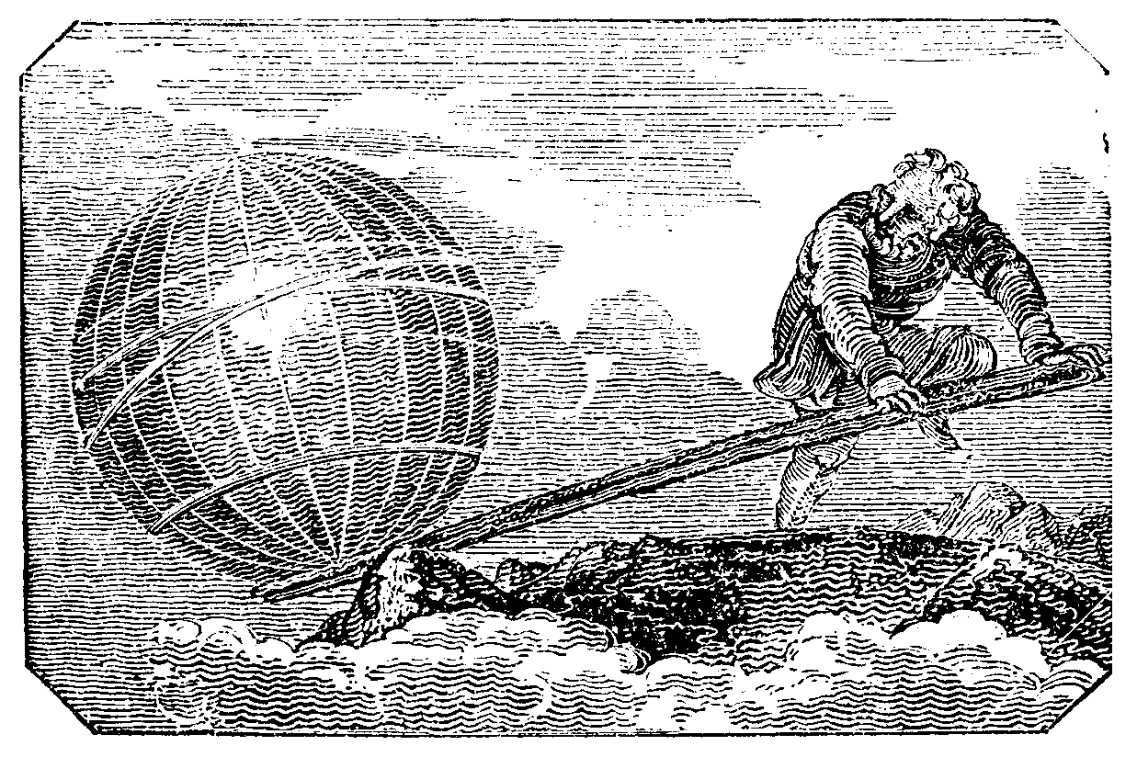
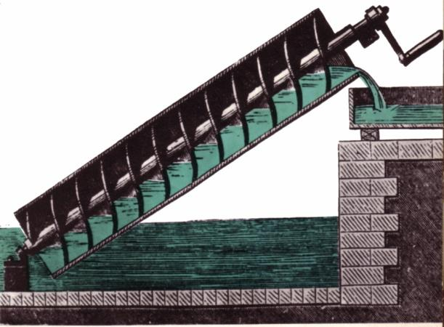
IV. GLORY OF GREECE
Use the three different levers to lift the stapler.
Which one was easiest?
Sketch that lever in your activity box for this section.
Greek Engineering

Slide 29
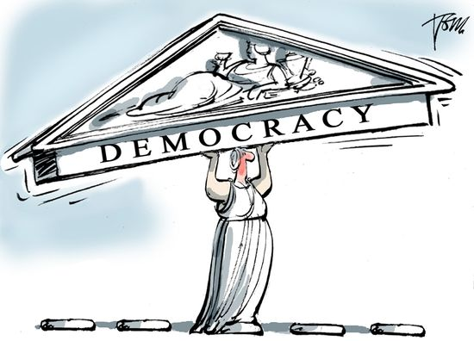
Greek Democracy
IV. GLORY OF GREECE
The foundation for our democratic republic began in Athens with their development of direct democracy.
Athenian citizens participated in government decisions by voting.
A council would propose laws and then all men over 18 years that wanted to could vote. The approved ideas would become laws.

Slide 30
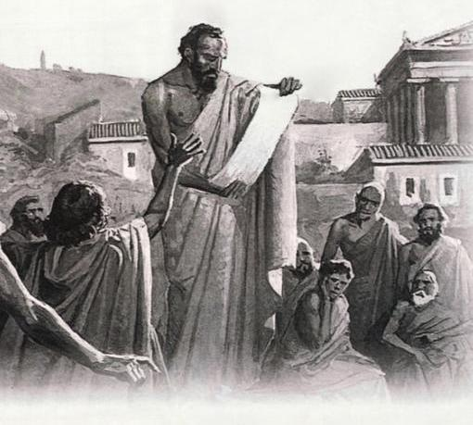
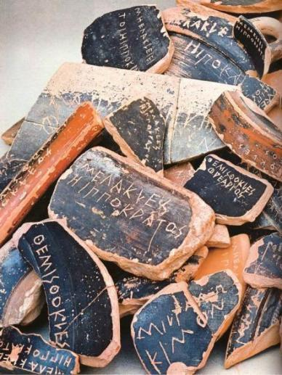
IV. GLORY OF GREECE
An important decision needs to be made at LCHS…Should students be able to leave campus for lunch?
Use the slips of paper to cast your ballot and vote now!
YES or NO
Greek Democracy

Slide 31
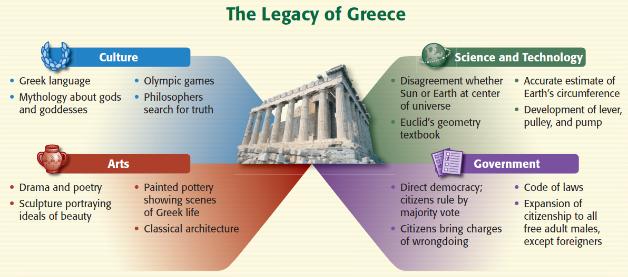
IV. GLORY OF GREECE
Why do you think scholars call this period in Greek history a “golden age”?
Which Greek achievement do you think is most important? Why?

