Slide 1

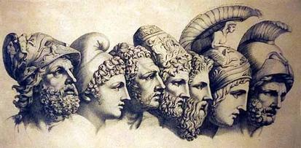
EARLY GREEKS
RISE OF GREEK CITY-STATES
CONFLICT AND WAR IN GREECE
GLORY OF GREECE
ALEXANDER THE GREAT
GREECE

Slide 2
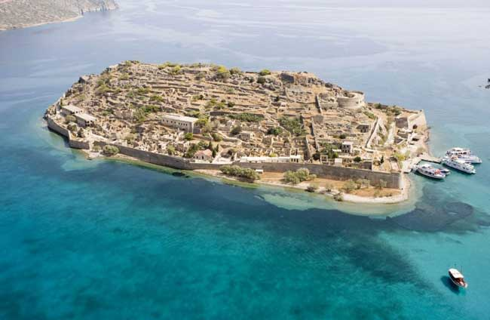
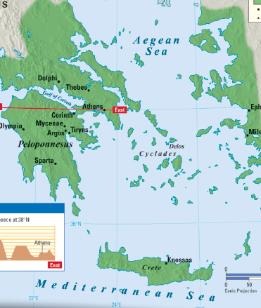
m
I. EARLY GREEKS
Minoans
    2700 - 1450 B.C. on the Island of Crete
    Palace complex of Knossos
      Brightly decorated with frescos and aspects of Minoan life
    Empire based on trade not conquest
      They traded with nearly everyone in the Mediterranean sea including egypt
https://youtu.be/P3Ez8drCIvc

Slide 3
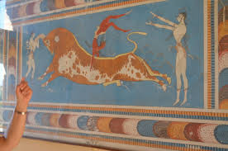
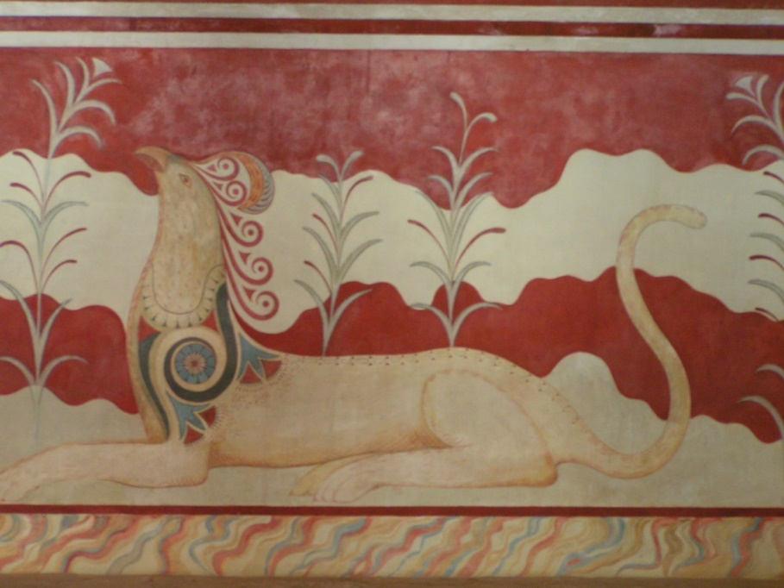
I. EARLY GREEKS
Minoans
The legendary King Minos took this early civilization to its highest peak from 1600BC – 1500BC
The palace of Knossos was so advanced that historians can ‘read’ the walls and get a full understanding of Minoan culture
Minoans gave women many rights and enjoyed many athletic activities like bull leaping

Slide 4
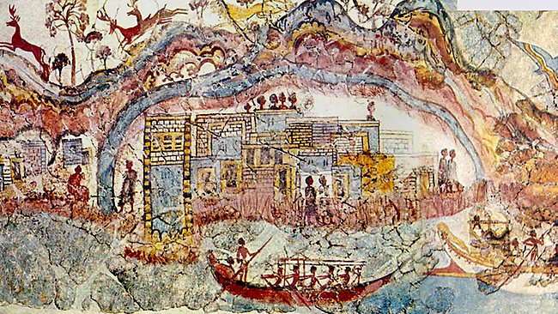
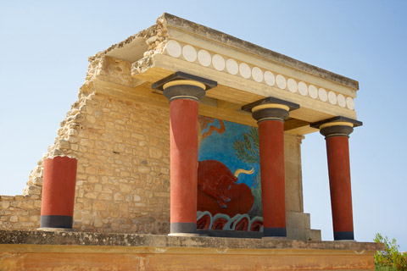
I. EARLY GREEKS
Minoans
The Minoan civilization ended around 1400 BC
Massive volcanic eruption showered Crete with debris, ash, and poison gas
Destroyed fleets with tidal waves
The Mycenaean civilization from mainland Greece invaded and destroyed what was left

Slide 5
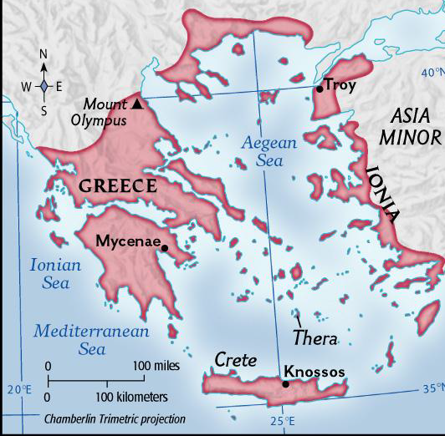
I. EARLY GREEKS
Mycenaeans
Mycenaean civilization dominated the Aegean world from 1400 BC – 1200 BC
mycenaeans
Minoans

Slide 6
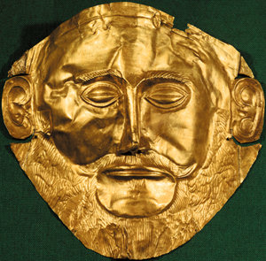
I. EARLY GREEKS
Mycenaeans
Sea traders – beyond Aegean Sea to Sicily, Italy, Egypt and Mesopotamia.
Warriors, living in several city states
The Mycenaean city-state became
the mainland Greek civilization.
Best known for Trojan War.
The Lions Gate at Mycenae
One of the most grand entrances in ancient history

Slide 7
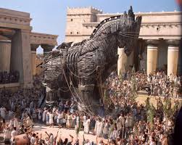
I. EARLY GREEKS
More on this guy later!!
Mycenaeans
Trojan War – Took place around 1250 BC
  Written about by Homer in the Iliad 500 years later.
  Between Mycenae and Troy over trading
  Story: Trojan Prince, Paris, takes the beautiful wife of Mycenae King, Agamemnon
  Mycenae go to rescue Helen – war lasts 10 years
  The Mycenaean Greeks lay siege to Troy for ten years, finally taking the city with the famous Trojan horse.
https://youtu.be/bpLtXIlkyYA
  http://youtu.be/YbiR6IMf5KQ

Slide 8
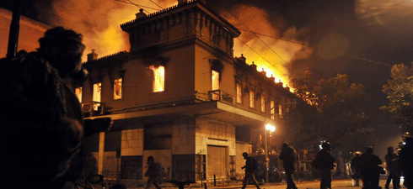
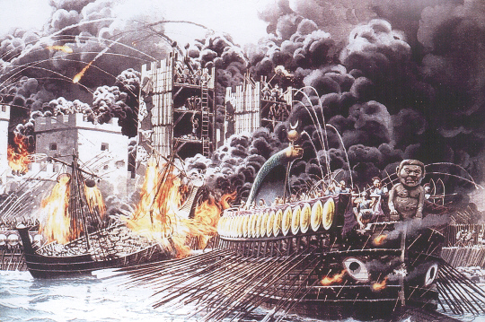
I. EARLY GREEKS
Dorians
From 1100 bc to around 800 bc
‘dark ages’ of Greece
Oversees trading stopped
People lost skills
People moved outside of cities to small towns

