Slide 1
GANGS AND CRIME

Slide 2
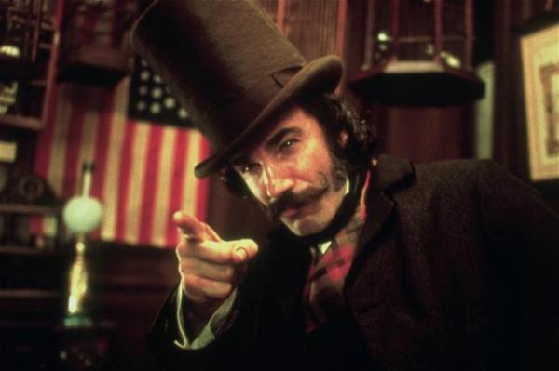
ORIGIN OF GANGS
Gangs have been in America since the 19th Century.
Q: What have gangs nearly always been centered on?
Neighborhoods (turf)
The five points in NYC – gangs of New York
Ethnic lines
Origin of birth, similar cultural characteristics
The Dead Rabbits – Gangs of NY
Protection
New immigrants had trouble assimilating
Lived together, worked together, fought together
Reputation
Had to establish themselves
Early America was cut-throat, so strength in numbers was important

Slide 3
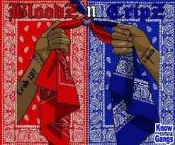
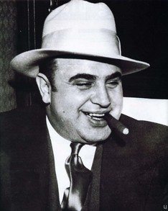
ORIGINAL GANGS
Cultural gangs
Irish
Scottish
German
English
Organized gangs
Italian Mafia
Inner city gangs (bloods, cripts)
Russian Mafia
Latino Gangs
Gangs of immigrants
They have a VERY organized hierarchy of members. With a leader or ‘boss’ and very strict discipline within the gang

Slide 4
GANGS - common
Estimated 25,000 gangs in the U.S. with 750,000 members.
Q: What are some characteristics of gangs?
Drug use
Drug trafficking (illegal selling of drugs)
Firearm sales
Auto theft
Prostitution
Racism
Sexism
Vandalism
What do these things have in common?
Money!

Slide 5
GANGS – common traits
Gangs associate themselves with one of several major gang “nations”
They use Symbols, Emblems, colors, phrases and clothing
Black and Yellow
Red and Black
Bricks
Tear drops
5-pointed Stars
Etc… many many more!
http://www.history.com/shows/gangland/videos/playlists/symbols-and-slang#gangster-gear
They use Graffiti to mark their territory
http://www.history.com/shows/gangland/videos/playlists/symbols-and-slang#gang-graffitti-marks-turf
Usually ages 10 – 30
Gang members usually DIE or go to JAIL by middle age
Violence (blood in, Blood out)
http://www.history.com/shows/gangland/videos/playlists/inside-a-gang#gangs-recruit-new-members
Constantly being arrested

Slide 6
Hierarchy – http://www.history.com/shows/gangland/videos/power-structures#power-structures
-how is this useful?
- Why are gangs organized?
Baddest gangs - http://www.history.com/shows/gangland/videos/playlists/inside-a-gang#baddest-gangs
- why do gangs have to be tough?
- what made these gangs the toughest?

Slide 7
GANGS – why people join
90% of members are male
10% are female
Only 10% are Caucasian (white)
Q: So…..why? - http://www.history.com/shows/gangland/videos/playlists/gang-activity#money
Friends and relatives in gangs
Difficult home life
Lack of success at school
Negative life view
Substance abuse
http://www.history.com/shows/gangland/videos/playlists/gang-activity#gangs-drugs
Little to no adult participation in their lives
Low self-esteem
SENSE OF BELONGING

Slide 8
GANGS – solving the problem
Outreach and intervention programs where workers and trained counselors encourage gangs members to become involved in positive, non-gang activities
EXAMPLES?.........
Provide greater opportunities for young people (job training, sports, clubs)
Use government agencies, schools, parents, religious organizations to increase awareness and develop opportunities
Organize prevention strategies for police and probation officers to identify gang members and get them off the streets
Prosecute gang members for illegal activity
Organize neighborhood watch groups, and remove graffiti that establishes “turf” for gangs

