Slide 1
CHAPTER 15 – GLOBAL AGE Sec. 2 & 3 Struggle for North America

Slide 2
Focus Question:
How did European struggles for power shape the North American Continent?
Warm-Up Question:
Who won the competition for North America?
who were the contenders?

Slide 3
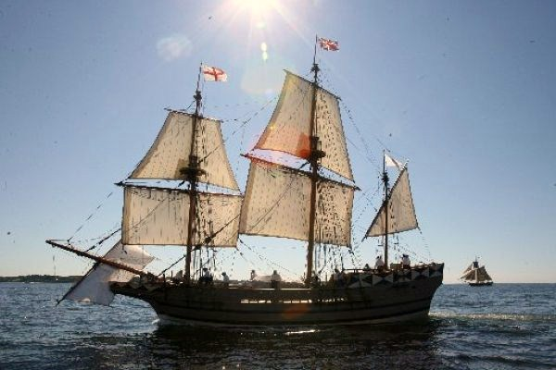
I. Beginning to colonize a new world

Slide 4
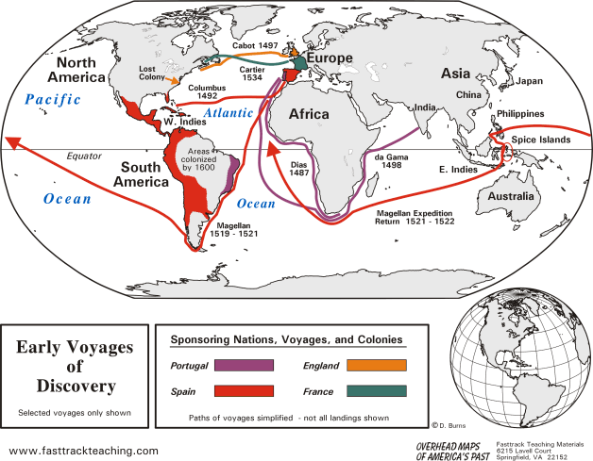

Slide 5
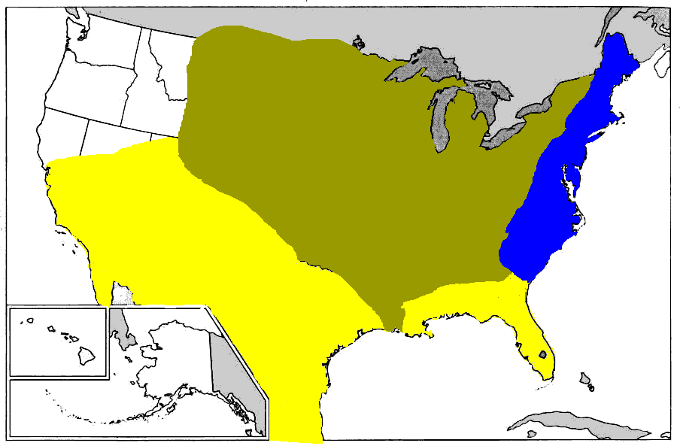
Which color was bigger? Which color was more powerful?

Slide 6
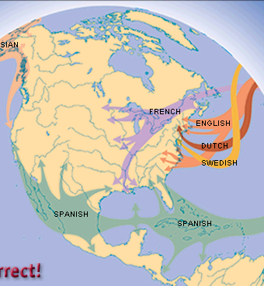

Slide 7
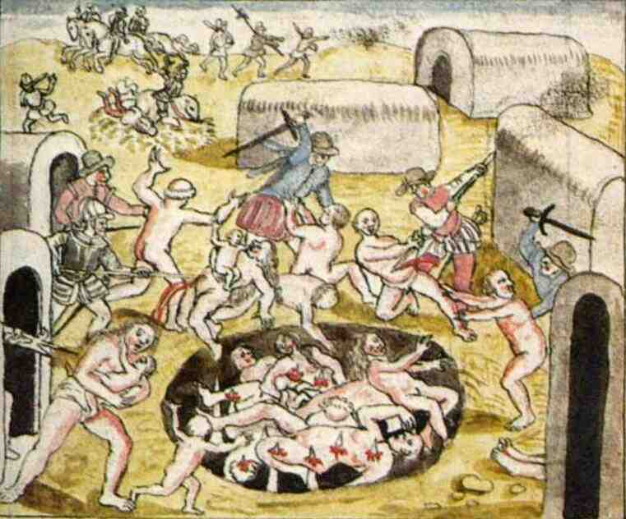
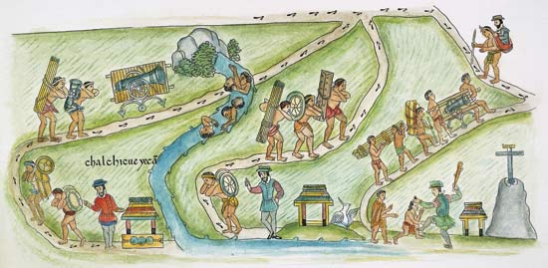
1. Spain and Portugal
The Spanish and Portuguese empires saw the benefits of exploiting the massive amounts of gold and silver in modern day Mexico and South America.
They ruthlessly imposed their cultural and political systems on the locals.
They believed that they deserved these riches because they were Christian and the Natives were not!
They used the natives to build their new colonies and to mine for gold and silver
To this day South America reflects the cultural diffusion of Spain, Portugal and Native Americans.

Slide 8
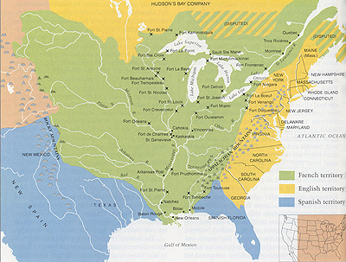
2. france
By the early 1500’s France began colonizing North America, hoping to strike it rich like Spain

Slide 9
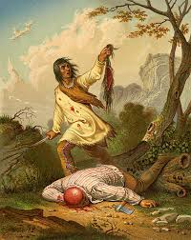
2. france
Too many Indians here!
Way too cold here!
Within 200 years, France claimed nearly half of North America
However, the population was less than 1/10 of the English Territory.
Why?
Too many mosquitos here!

Slide 10
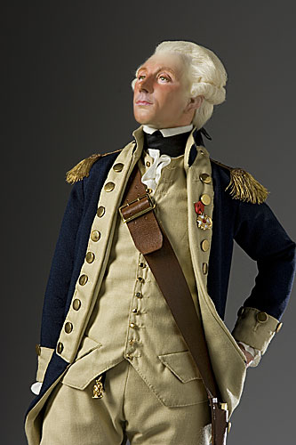
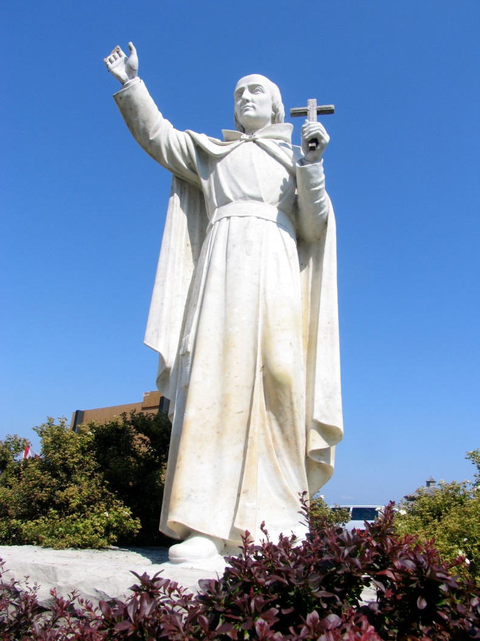
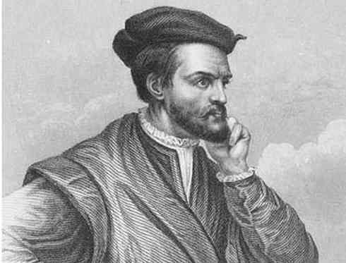
2. France continued
Jacques Cartier discovered the St. Lawrence River, allowing for boats to get from the Atlantic Ocean all the way to the Great Lakes.
Marquette and Lafayette explored down the Ohio and Illinois Rivers
Lafayette discovered the mighty Mississippi, which then lead all the way to the Gulf of Mexico at New Orleans!

Slide 11
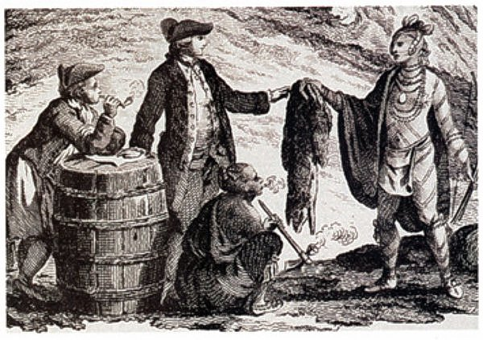
2. France continued
French made money off of trade
They traded guns and alcohol for beaver skins
French settlements were a failure compared to Spanish and English.
They simply picked the wrong spot to colonize

Slide 12
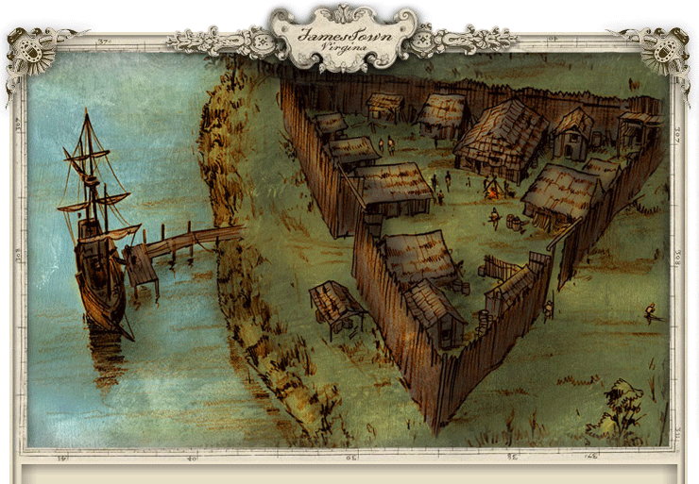
3. england
Jamestown was the first permanent colony for the English in 1607.
Almost everyone died, due to starvation, until the Indians helped them grow tobacco which they shipped back to England – bring more settlers and reviving the colony.

Slide 13
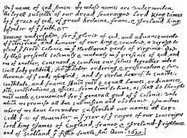
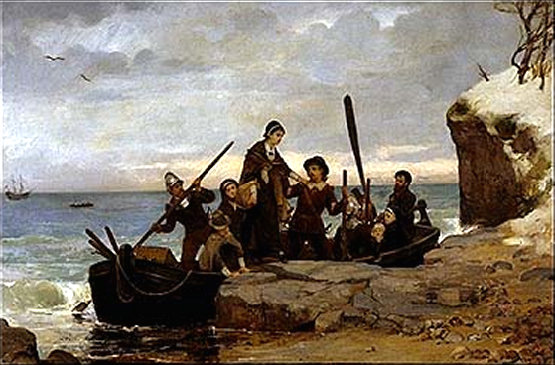
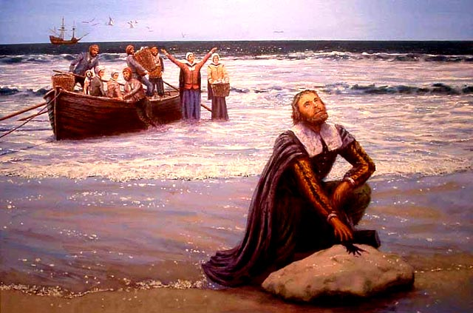
3. England continued
1620 the Pilgrims landed in Cape Cod Massachusetts.
They found a permanent home at Plymouth Rock
The were Protestants that rejected the Church of England and sought religious freedom
They signed the Mayflower Compact (named after their ship) agreeing to help each other and live in peace.

Slide 14
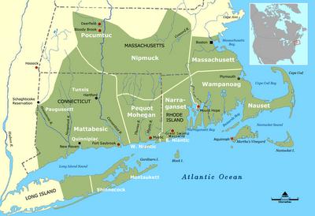
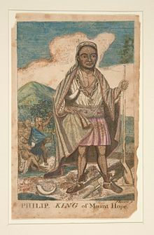
3. England continued
The peace with
the Indians did last forever (contrary to
what we learn at
Thanksgiving)
From 1675-1676
English colonists fought a war against the Indians on the East coast called King Philip’s war
King Philip was an
Indian named Metcom who was fed up with colonists stealing land and mistreating Indians.

Slide 15
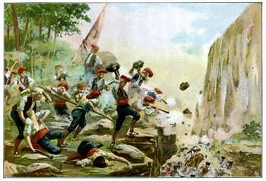
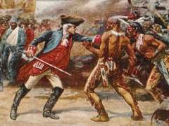
3. England continued
By the late 1600’s and 1700’s France and England were fighting wars against each other all over the world, including in America
In 1754 a war between the French and their Indian allies and the English began in America
This war was called the French and Indian War, in America and the Seven Years war in Europe

Slide 16
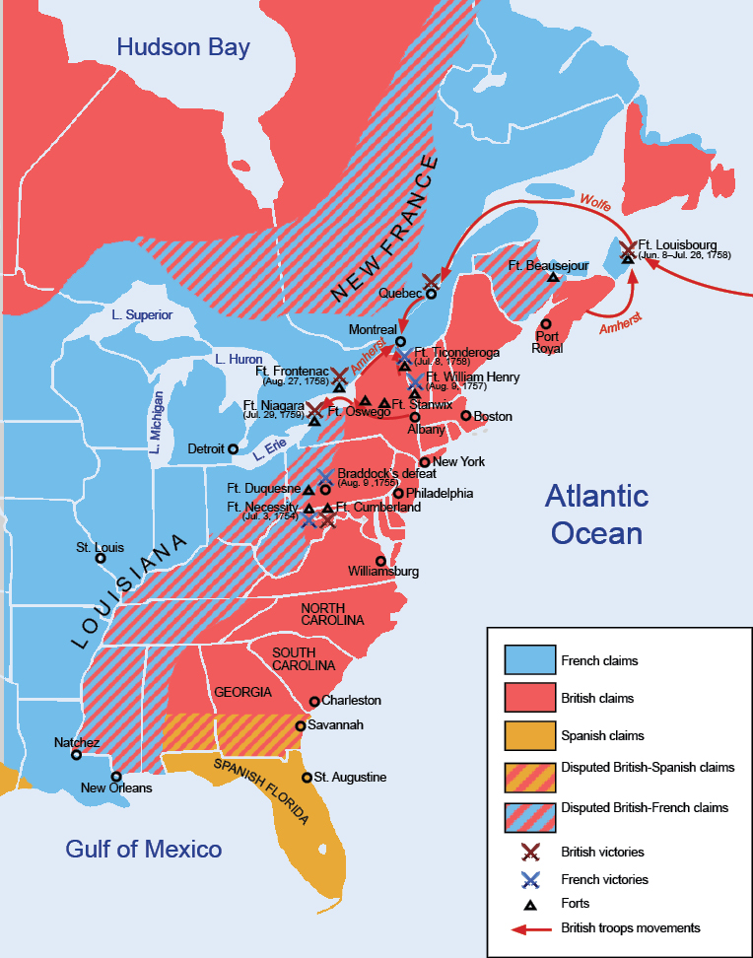
3. England continued
The Treaty of Paris ended this worldwide war in 1763
The Treaty expanded English and Spanish Territory
This war all but eliminated France from America

