Slide 1
CH. 4
SECT. 1 – GET TO KNOW YOURSELF

Slide 2
VALUES
Life values: standard to live by
Work values: principles that are most important to you in
your work

Slide 3
Life and work values
Income and wealth – how important is wealth?
Security – is job security important to you?
Independence – do you want to have to follow company rules?

Slide 4
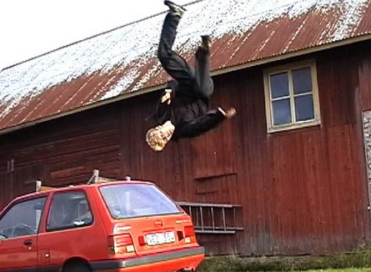
Life and work values
Physical risk: are you willing to get risky in your job? Adventurous?
Recognition: how important is gaining other people’s respect?

Slide 5
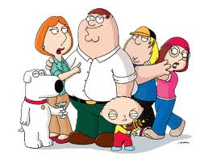
Life and work values
Creativity: how important is creating new ideas?
Personal growth: do you want a job that allows you to growth educationally?
Family : how important is time with your family?

Slide 6
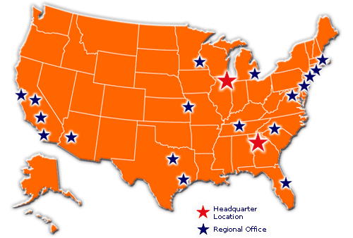
Life and work values
Community: how important is you time in your community?
Location: how important is the place where you live?

Slide 7
INTERESTS
If you get a job at age 18, and work 40 hours a week until you are 67 (average retirement age) you will work 100,000 hours!!!
FIND SOMETHING YOU LOVE TO DO!!

Slide 8
PERSONAL INTERESTS
Find things that are interesting to you now, as a teenager, understand what makes you happy!
Take out a sheet of paper
Divide it into 3 sections
On the left side write 30 ACTIVITIES that you do in a week
In the middle write whether you think that activity is WORK OR PLAY?
On the right side, write what job you believe would work for this activity.
WHAT DOES THIS SAY ABOUT YOU?

Slide 9
Aptitude
Aptitude is a natural talent for learning certain skills.
VERBAL APTITUDE: the ability to write clear and interesting.
NUMERICAL APTITUDE: ability to work with numbers quickly and accurately
SPATIAL APTITUTDE : ability to “see” what something will look like from a verbal description or photograph
MANUAL DEXTERITY: ability to fix things and build things and to do other physical work
PHYSICAL COORDINATION: the ability to execute precise muscle movements - sports
Common aptitudes

Slide 10
PERSONALITY
Personality is the blend of qualities that defines you as an individual based on what you think, feel, and believe.
REALISTIC: people that always want to know what is going on around them- truth seekers
INVESTIGATIVE: people that like to know WHY things happen
CREATIVE: people that like to be involved in free, unrestricted activities.
SOCIAL: people that like to work with other people – they prefer group activities
ENTERPRISING: people that like to lead and direct others in achieving a goal.
PERSONALITY TYPES

