Slide 1
- INTRODUCTION TO LAW -
WHAT IS LAW?
LAWS AND VALUES
KINDS OF LAWS
CONSTITUTIONAL FRAMEWORK
CRIMES IN AMERICA

Slide 2
I. WHAT IS LAW?
DEFINE LAW…
What is it?
What does it include?
What is the difference between a law and a rule?

Slide 3
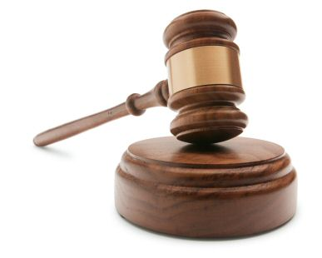
I. WHAT IS LAW?
LAW is defined as that set of rules or regulations by which a government regulates the conduct of people within a society.
A Rule is NOT regulated by a government – it is set by a non-governing body (school, Hospital, store)

Slide 4
I. WHAT IS LAW?
The field of study known as JURISPRUDENCE is devoted to answering the question of what is law.
Law Schools are dedicated to the study of Jurisprudence
Lawyers and Judges must be masters of the Law!
No one knows everything about law – it is too extensive!
Law is very subjective and can be interpreted many different ways.

Slide 5
I. WHAT IS LAW? - history of law
Hammurabi’s Code: First ever written Laws (2,500 BC)
Biblical Law: Greatest moral influence on American Law and society (1,500 BC)
Greek Law: Emphasis on citizen involvement and the origin of juries, elections and judges (800 BC)
Roman Law: Origin of citizens being represented by lawyers and impacted most modern legal codes – first time rights were given (300 BC)
Justinian’s Code: first ever civil laws recorded (600 AD)
Napoleonic Code: Still used throughout Europe and impacted the U.S. tremendously (1800 AD)

Slide 6
II. LAWS AND VALUES
Laws should reflect society’s values
Just because something is wrong morally doesn’t make it illegal.
Goals of the Legal System:
Protect human rights
Promote Fairness
Help to resolve conflicts
Promote order and stability
Promote desirable social and economic behavior
Respect the will of the majority
Protect the rights of the minority
SHOULD LAWS INTERFERE WITH IMPORTANT VALUES?
ARE LAWS MEANT TO SOLVE ALL OF OUR PROBLEMS?

Slide 7
II. LAWS AND VALUES
Laws reflect the NEEDS of society
(Should laws be moral and should morals be laws)
Laws are to be followed by everyone from the homeless to the President.
(Should anyone ever be able to break a law?)
(Should the President ever be able to break a law?)
(If a law is ‘dumb’ should you be able to break it?)

Slide 8
III. Kinds of Laws
Laws are in 2 major groups:
CRIMINAL
CIVIL

Slide 9
III. Kinds of Laws
1. Criminal Law
Criminal laws regulate public conduct and set out duties owed to society. Criminal laws have penalties like imprisonment, fines and supervision….and sometimes death
Felony – a more serious crime that requires a maximum penalty of more than 1 year in prison
Murder, Rape, armed Robbery, Assault and Battery
Misdemeanor – less serious crime that requires a prison term of one year or less
Speeding ticket, minor shoplifting

Slide 10
III. Kinds of Laws
2. Civil Law
Civil laws regulate relations between individuals or groups of individuals
A Civil Action is a lawsuit that can be brought by a person who feels wronged by another person.
Civil laws have penalties that usually require a monetary payment of some kind
Civil laws will be taken care of in civil courtrooms or small claims courts – like judge Judy!
examples: Divorce, auto accident, insurance, contracts, etc…

Slide 11
III. Kinds of Laws
1. Criminal Law
DEFENDANT – the person defending himself in the trial. – He is usually defended by a team of lawyers
PROSECUTION – the team of lawyers appointed by the State the crime was committed in to put the defendant in jail in a criminal trial!
PLAINTIFF – The person or company harmed – bringing the lawsuit

Slide 12
III. Kinds of Laws
Proving Doubt
BURDEN OF PROOF – Someone has the job or task of proving the guilt in a case – this is the burden of proof
In a CRIMINAL CASE the burden of proof falls on the prosecution
In a CIVIL CASE the burden of proof falls on the plaintiff
Remember: you are INNOCENT until PROVEN guilty in the court of law!

Slide 13
III. Kinds of Laws
Proving Doubt
In a criminal case: the prosecution must prove that the defendant is guilty beyond a reasonable doubt!
The jury must be 100% convinced that the defendant is guilty
In a civil case: the plaintiff must prove that the defendant was guilty of the crime – called preponderance of the evidence!
The Judge (There is no jury in a civil trial) must be convinced that the defendant is at least 51% guilty – just more than half

Slide 14
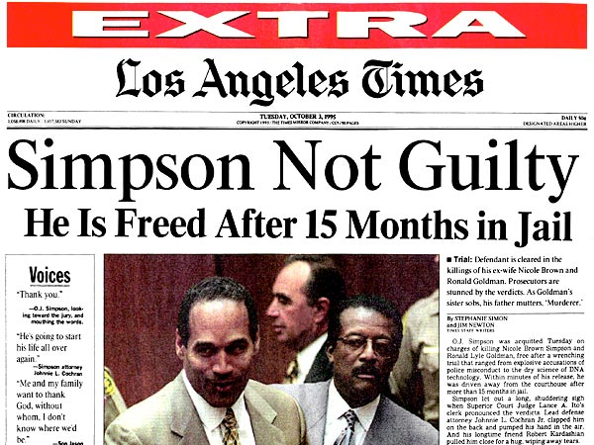
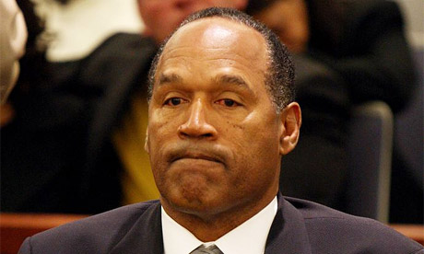
CRIMINAL CASE
BURDEN OF PROOF – PROSECUTION
MUST PROVE – BEYOND A REASONABLE DOUBT 100%
IV. Legal Terms
THERE WAS ENOUGH EVIDENCE TO PROVE O.J. AT LEAST 51% GUILTY OF BEING RESPONSIBLE FOR THE MURDERS
THERE WAS NOT ENOUGH EVIDENCE TO PROVE O.J. 100% GUILTY OF THE MURDERS
CIVIL CASE
BURDEN OF PROOF – PLAINTIFF
MUST PROVE – PREPONDERENCE OF THE EVIDENCE >51%

Slide 15
IV. Constitutional Framework
Marbury vs. Madison (1801)
The United States Constitution is the highest law of the land!
It outline government powers
Limits those powers
Provides rights to all citizens
Laws are different depending on what state you live in.
Judicial Review – enables a court to declare unenforceable any law passed by Congress or a state legislature that conflicts with the Constitution.
Federalism – the division of power between states and the federal government

Slide 16
V. CRIME IN AMERICA
A crime is something one does or fails to do that is in violation of a law.
Crimes are not always easy to determine
Law is very subjective!
(who determines what is a crime and what isn’t?)
The police or the District Attorney

Slide 17
V. CRIME IN AMERICA
IS THE GUN THE PROBLEM OR THE PERSON WHO OWNS THE GUN?
Guns and the law – the 2nd amendment allow Americans to own firearms
Limits on guns:
Gun Control Act of 1968 – prohibits certain people from buying or owning guns (convicted felons, minors, illegal immigrants)
Brady Act (1993) – mandatory background checks before selling a firearm
(in 2004 8.1 million people applied for guns and 126,000 were rejected)
DO WE NEED SOME RESTRICTIONS ON GUNS?

Slide 18
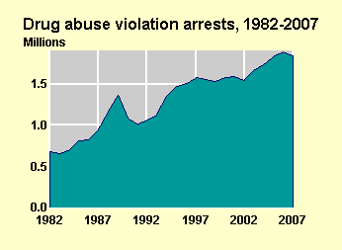
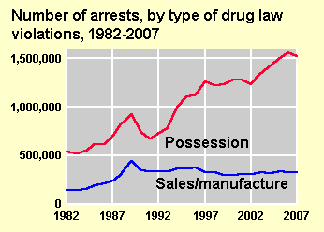
V. CRIME IN AMERICA
Drugs and the law – illegal drug use costs society billions of dollars a year!
50% - 75% of people taken to jail test positive for 1 or more drugs at the time of their arrest!

Slide 19
V. CRIME IN AMERICA
Crime numbers:
Property crimes reported: 9,983,568 % Arrested – 15%
Total violent crimes reported: 1,417,745 % Arrested – 43%
---------------------------------------------------------
Total crime index: 11,401,313 % Arrested – 19%
What type of crimes are people most likely to be arrested and why?
How can citizens act to help police improve arrest rates?

Slide 20
V. CRIME IN AMERICA
Crime clock
47 murders / day
14 murders per school day
369 rapes / day
11 rapes per class period
847 robberies / day
26 robberies per class period
69 assaults per class period
119 burglaries per class period
473 thefts per class period
65 cars stolen per class period

Slide 21
V. CRIME IN AMERICA
Crime in America

Slide 22
V. CRIME IN AMERICA
The National Council on Crime and Delinquency (NCCD) studied criminal justice in the US from 1907 – 2006 and recommended the following strategies for reducing crime:
Build safer communities with special attention to safe schools, after-school programs, community policing and the preventions of domestic violence and child abuse.
Reduce the costs and improve the fairness of the criminal justice system

Slide 23
V. CRIME IN AMERICA
Develop cost-effective alternatives to prison, reserving prison for those who cannot be safely treated in community based programs.
Create effective drug-control policies. Reduce funds spent on catching drug sellers and users; expand funding for drug treatment and job training, and repeal laws requiring mandatory prison sentences for drug possession.

Slide 26
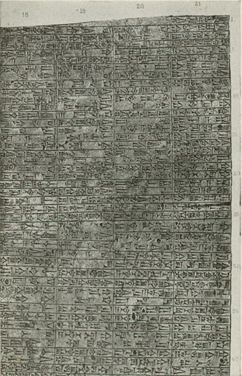
I. History of Law
Hammurabi’s Code - one of the first written codes of law in recorded history. 1750 BC (almost 4,000 years ago).
laws based both on retribution and restitution, but mostly on retribution.
Hammurabi’s Code
Retribution= ‘Eye for an eye’ justice based on vengeance
For example: “If fire break out in a house, and some one who comes to put it out cast his eye upon the property of the owner of the house, and take the property of the master of the house, he shall be thrown into that self-same fire.”
Restitution= repayment to a victim for harmful actions
For example: “Any one who opens his ditches to water his crop, but is careless, and the water floods the field of his neighbor, then he shall pay his neighbor corn for his loss.”

Slide 27
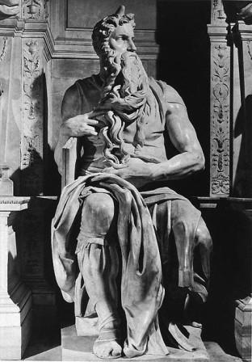
I. History of Law
Biblical Law
The laws of Moses AKA biblical law - or Hebrew law - The Ten Commandments - 1250 BC
more concerned with punishing a deliberate action than an accidental act of harm
care for the poor was expressed
both the Code of Hammurabi and the Mosaic Law show the importance of respect for the parents

Slide 28
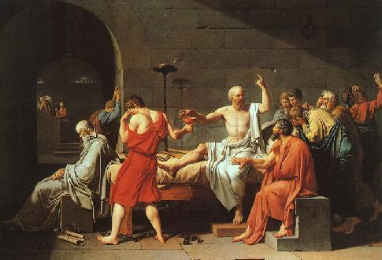
Greek law
I. History of Law
Greek Law – Practiced in ancient Athens – the first known Democracy in the World – 400 BC
Only a small number of people in ancient Greece (Athens) were recognized as citizens and had political rights.
citizens excluded women, children, aliens and slaves
Women who were on trial were not allowed to speak for themselves
Responsibilities of the citizen included voting, jury duty and the running of the country

Slide 29
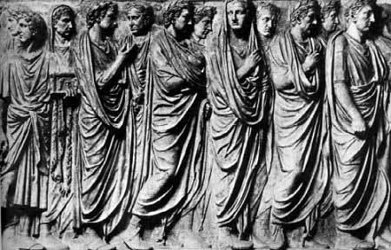
I. History of Law
Roman law
Roman law - Practiced in the Roman Republic (509 BC – 31 BC) is based on two basic principles:
(1) the law must be recorded
(2) justice cannot be left in the hands of judges alone to interpret
The Twelve Tablets of Roman Law are now considered the foundation of modern law
laws reflected a patriarchal society - women had no status as persons

Slide 30
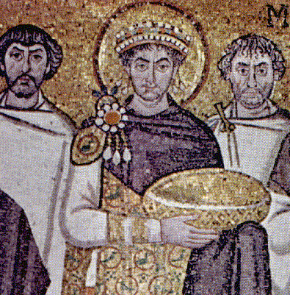
I. History of Law
Justinian’s Code
Byzantine Emperor Justinian commissioned ten men to study and clarify the 1600 books of Roman Law – 527 AD
The term ‘justice’ is derived from Justinian’s name
Formed the basis of civil law (laws governing personal relationships) which, along with criminal law, became one of the main legal systems to govern western civilization

Slide 31
I. History of Law
The Napoleonic Code
Napoleon commissioned a new code of laws called the Napoleonic Code - 1804
The Napoleonic Code served as the prototype for later codes during the 19th century in 24 countries
The Code, is regarded as the first modern counterpart to roman law, and is currently in effect in France

Slide 32
III. U.S. Legal System
The 5 Main Sources of U.S. Law
Constitutional Law
(Federal and State)
Common Law
Statutory Law
Court Decisions
Administrative Regulations

Slide 33
III. U.S. Legal System
# 1 Constitutional Law
The U.S. Constitution:
Is the most fundamental law in our Country.
Defines the limits of the federal and state governments for passing laws.

Slide 34
III. U.S. Legal System
# 2 Common Law
Judges or “Magistrates” traveled the countryside deciding cases on local customs and traditions.
Judges share their decisions with other Judges, and this became the basis for “Common Law.”
Eventually, decisions were written down and a body of cases was developed.
Precedent – A Judge is required to follow an earlier court decision when deciding a case with similar circumstances.
Stare Decisis – “Let the decision stand”

Slide 35
III. U.S. Legal System
# 3 Statutory Law
Statutes – Laws specifically passed by a governing body that has been created for the purpose of making laws.
Includes all laws passed by Congress, State Legislatures, Local City Councils or Town Meetings.

Slide 36
III. U.S. Legal System
# 4 Court Decisions
Courts make law in 3 ways:
By Interpreting Statutes – A judge can interpret an unclear statute, only if the judge is involved in a related lawsuit.
By Judicial Review – Supreme Court can declare laws Unconstitutional.

Slide 37
III. U.S. Legal System
# 5 Administrative Regulations / Agencies
Organizations created by Federal, Local, and State Legislatures for regulating individual activities.
Provides an organization with expert knowledge to govern a specific field
Example = Federal Communications Commission (FCC)
OSHA, CIA, FBI, WTO

Slide 38
1. Criminal Law
IV. Legal Terms
Felony Classes:
1st degree murder
2nd degree murder
Manslaughter
Class X Felony
Between 6 and 30 years in State Penitentiary
Class 1 Felony
Between 4 and 15 years in State Penitentiary
Class 2 Felony
Between 3 and 7 years in State Penitentiary
Class 3 Felony
Between 2 and 5 years in State Penitentiary
Class 4 Felony
Between 1 and 3 years in State Penitentiary

Slide 39
1. Criminal Law
IV. Legal Terms
Misdemeanor Classes:
Class A Misdemeanor
Up to 1 year in Jail; and/or
Class B Misdemeanor
Up to 6 months in Jail; and/or
Class C Misdemeanor
Up to 30 days in Jail; and/or

Slide 40
II. Kinds of Laws
1. Criminal Law
There are 3 levels of lawmaking:
FEDERAL LAWS (STATUTES)
https://www.law.cornell.edu/uscode/text
Passed by the U.S. Government
Or Ruled on by the U.S. Supreme Court
Apply to every citizen in America
STATE LAWS
http://www.ilga.gov/legislation/ilcs/ilcs.asp
Passed by a State Government
Or Ruled on by the State Supreme Court
Apply to every citizen in that State
LOCAL LAWS (ORDINANCES) https://www.municode.com/library/il/peoria/codes/code_of_ordinances
Passed by a local town or city
Apply to every citizen in that town, city or county

